Slide 1


Lightweight Incremental Query Processing for Update-Intensive Applications
Yanif Ahmad
yanif@cs.cornell.edu
Database Group, Cornell University

Slide 2

Databases: A 30-second Refresher
Database management systems (DBMS) are computer programs to store and access structured data
Basic unit of data: records (rows, or tuples)
A DBMS organizes collections of records into tables (or relations)
Databases consist of many relations
Employees
id | name | address | DOB | wages
1 | John | 108 Vanilla … | 7/11/1980 | $100k
2 | Sarah | 247 Bowen… | 4/22/1982 | $120k
3 | Eric | 12 Oakdale… | 2/27/1978 | $80k
4 | Cassie | 103 Medway.. | 5/28/1983 | $70k
5 | Greg | 90 Tachbrook.. | 2/12/1978 | $180k
6 | Julie | 70 Rocham… | 2/23/1978 | $90k

Slide 3
Databases: Query Processing
Queries are posed in a declarative language (SQL)
Queries state “what you want” (spec) not “how to get it” (algorithm)
A query compiler and optimizer generates an “algorithm” (query plan) under the hood
The query plan is made up of “operators” -- a standard set of data processing primitives defined by the relational algebra
select c.customer_id, sum(orders.price)
from customers c, orders o
where c.customer_id = o.customer_id
group by c.customer_id
∑
cid | sum(p)
1 | $60
2 | $120
3 | $170
⨝
cid | name | address
1 | John | 108 Van..
2 | Jenny | 245 Bow..
3 | Manny | 128 Ful…
oid | cid | price
1 | 3 | $100
2 | 3 | $70
3 | 2 | $120
4 | 1 | $60

Slide 4
Databases: Query Processing
Queries are posed in a declarative language (SQL)
Queries state “what you want” (spec) not “how to get it” (algorithm)
A query compiler and optimizer generates an “algorithm” (query plan) under the hood
The query plan is made up of “operators” -- a standard set of data processing primitives defined by the relational algebra
select c.customer_id, sum(orders.price)
from customers c, orders o
where c.customer_id = o.customer_id
group by c.customer_id
∑
cid | sum(p)
1 | $60
2 | $120
3 | $170
⨝
cid | name | address
1 | John | 108 Van..
2 | Jenny | 245 Bow..
3 | Manny | 128 Ful…
oid | cid | price
1 | 3 | $100
2 | 3 | $70
3 | 2 | $120
4 | 1 | $60

Slide 5
Databases: Query Processing
Queries are posed in a declarative language (SQL)
Queries state “what you want” (spec) not “how to get it” (algorithm)
A query compiler and optimizer generates an “algorithm” (query plan) under the hood
The query plan is made up of “operators” -- a standard set of data processing primitives defined by the relational algebra
select c.customer_id, sum(orders.price)
from customers c, orders o
where c.customer_id = o.customer_id
group by c.customer_id
∑
cid | sum(p)
1 | $60
2 | $120
3 | $170
⨝
cid | name | address
1 | John | 108 Van..
2 | Jenny | 245 Bow..
3 | Manny | 128 Ful…
oid | cid | price
1 | 3 | $100
2 | 3 | $70
3 | 2 | $120
4 | 1 | $60

Slide 6
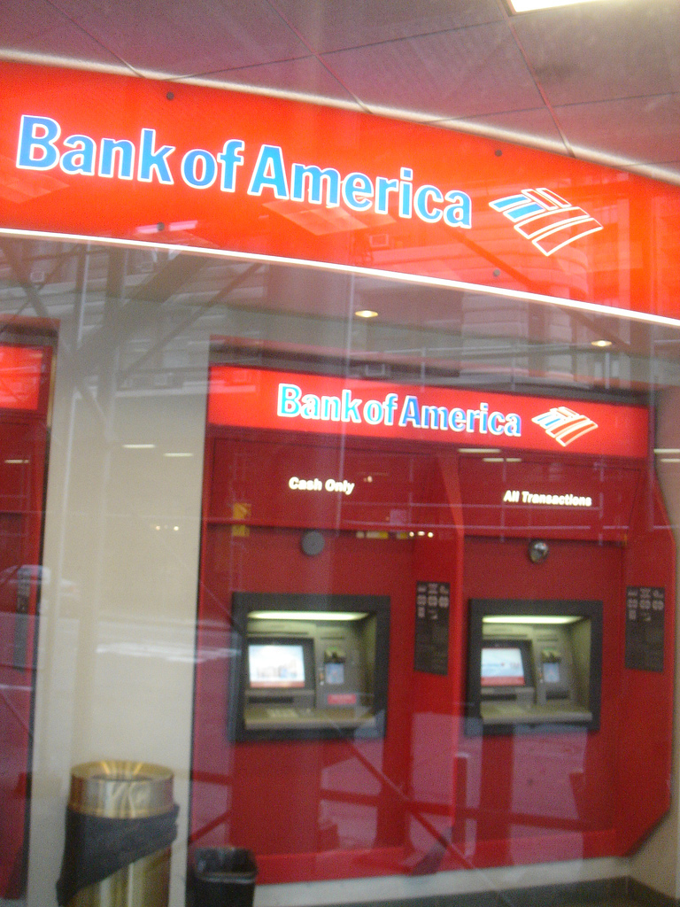
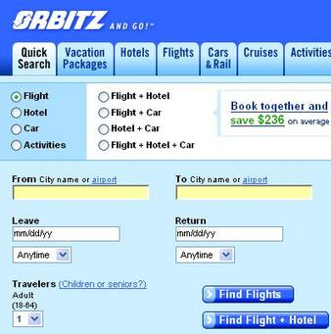
DBMS Apps in the 1960s
Online transaction processing (OLTP)
Transaction: unit of work, with ACID properties
Applied in: banking, airlines, e-commerce, etc.
Example queries:
what were the withdrawals I made from my checking account yesterday?
what direct flights are available on March 15th from New York to Rome?

Slide 7
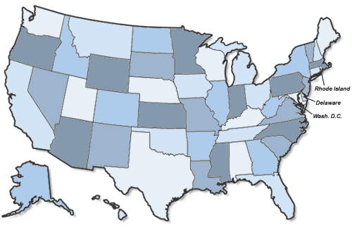
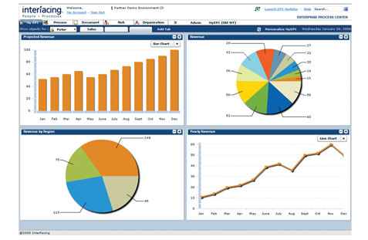
DBMS Apps in the 1980s
Online analytical processing (OLAP)
Analytical queries compute categorized statistics (i.e. aggregates)
Used for business intelligence (sales, marketing, logistics, etc.)
Example queries:
what is the total number of games consoles purchased by females between 19 and 45?
what were the total sales of digital cameras in NY state in 2008 and 2009?
Target stores

Slide 8
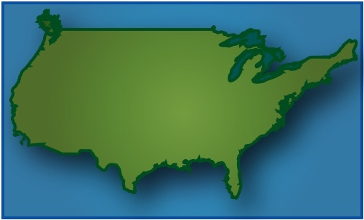


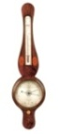
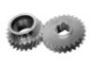

DBMS Apps in the Mid-2000s
Data stream processing:
Continuously arriving data, continuously evaluated queries
Applications:
Computer network monitoring
Environmental monitoring
Example query:
which weather stations detected wind gusts above 40 mph and 20 mph in the last 2 hours?
Data stream management system (DSMS)
Data stream
Windowed results
Continuous queries
Memory
Disk
Storage
Straight-through processing architecture

Slide 9

Apps in the 2010s: Algorithmic Trading
High-frequency algorithmic trading on order books
Q1/2009: 73% of all equities trades in the US
~15% annual profit margin industry-wide
Order book trading
Actions:
Algos: insertions, deletions of bid and ask orders
Exchange: matching (potentially partial) of bids and asks
Queries:
Algo strategies
Exchange simulation for backtesting
t = timestamp | oid = order id | bid = broker id | p = price | v = volume
Bid order book (buyers)
Ask order book (sellers)
t | oid | bid | p | v
2526035 | 36721 | NITE | 184000 | 1500
2526690 | 36909 | MASH | 183200 | 200
2527543 | 37001 | MSCO | 182700 | 3000
2528321 | 37008 | GSCO | 182500 | 500
2529032 | 37011 | FBCO | 181900 | 600
t | oid | bid | p | v
2526345 | 36750 | GSCO | 184000 | 1000
2527389 | 37002 | MSCO | 185200 | 200
2527928 | 37006 | GSCO | 186100 | 500
2528894 | 37020 | NITE | 186800 | 500
2529758 | 37032 | MASH | 187900 | 700
Electronic exchange
(e.g., NYSE, NASDAQ)

Slide 10
Apps in the 2010s: Algorithmic Trading
High-frequency algorithmic trading on order books
Q1/2009: 73% of all equities trades in the US
~15% annual profit margin industry-wide
Order book trading
Actions:
Algos: insertions, deletions of bid and ask orders
Exchange: matching (potentially partial) of bids and asks
Queries:
Algo strategies
Exchange simulation for backtesting
t = timestamp | oid = order id | bid = broker id | p = price | v = volume
Bid order book (buyers)
Ask order book (sellers)
t | oid | bid | p | v
2526035 | 36721 | NITE | 184000 | 1500
2526690 | 36909 | MASH | 183200 | 200
2530574 | 37055 | NITE | 183000 | 300
2527543 | 37001 | MSCO | 182700 | 3000
2528321 | 37008 | GSCO | 182500 | 500
2529032 | 37011 | FBCO | 181900 | 600
t | oid | bid | p | v
2526345 | 36750 | GSCO | 184000 | 1000
2527389 | 37002 | MSCO | 185200 | 200
2527928 | 37006 | GSCO | 186100 | 500
2531230 | 37075 | FBCO | 186400 | 1000
2528894 | 37020 | NITE | 186800 | 500
2529758 | 37032 | MASH | 187900 | 700
Electronic exchange
(e.g., NYSE, NASDAQ)

Slide 11
Apps in the 2010s: Algorithmic Trading
High-frequency algorithmic trading on order books
Q1/2009: 73% of all equities trades in the US
~15% annual profit margin industry-wide
Order book trading
Actions:
Algos: insertions, deletions of bid and ask orders
Exchange: matching (potentially partial) of bids and asks
Queries:
Algo strategies
Exchange simulation for backtesting
t = timestamp | oid = order id | bid = broker id | p = price | v = volume
Bid order book (buyers)
Ask order book (sellers)
t | oid | bid | p | v
2526035 | 36721 | NITE | 184000 | 1500
2526690 | 36909 | MASH | 183200 | 200
2530574 | 37055 | NITE | 183000 | 300
2528321 | 37008 | GSCO | 182500 | 500
2529032 | 37011 | FBCO | 181900 | 600
t | oid | bid | p | v
2526345 | 36750 | GSCO | 184000 | 1000
2527389 | 37002 | MSCO | 185200 | 200
2527928 | 37006 | GSCO | 186100 | 500
2531230 | 37075 | FBCO | 186400 | 1000
2528894 | 37020 | NITE | 186800 | 500
2529758 | 37032 | MASH | 187900 | 700
Electronic exchange
(e.g., NYSE, NASDAQ)

Slide 12
Apps in the 2010s: Algorithmic Trading
High-frequency algorithmic trading on order books
Q1/2009: 73% of all equities trades in the US
~15% annual profit margin industry-wide
Order book trading
Actions:
Algos: insertions, deletions of bid and ask orders
Exchange: matching (potentially partial) of bids and asks
Queries:
Algo strategies
Exchange simulation for backtesting
t = timestamp | oid = order id | bid = broker id | p = price | v = volume
Bid order book (buyers)
Ask order book (sellers)
t | oid | bid | p | v
2526035 | 36721 | NITE | 184000 | 500
2526690 | 36909 | MASH | 183200 | 200
2530574 | 37055 | NITE | 183000 | 300
2528321 | 37008 | GSCO | 182500 | 500
2529032 | 37011 | FBCO | 181900 | 600
t | oid | bid | p | v
2527389 | 37002 | MSCO | 185200 | 200
2527928 | 37006 | GSCO | 186100 | 500
2531230 | 37075 | FBCO | 186400 | 1000
2528894 | 37020 | NITE | 186800 | 500
2529758 | 37032 | MASH | 187900 | 700
Electronic exchange
(e.g., NYSE, NASDAQ)

Slide 13


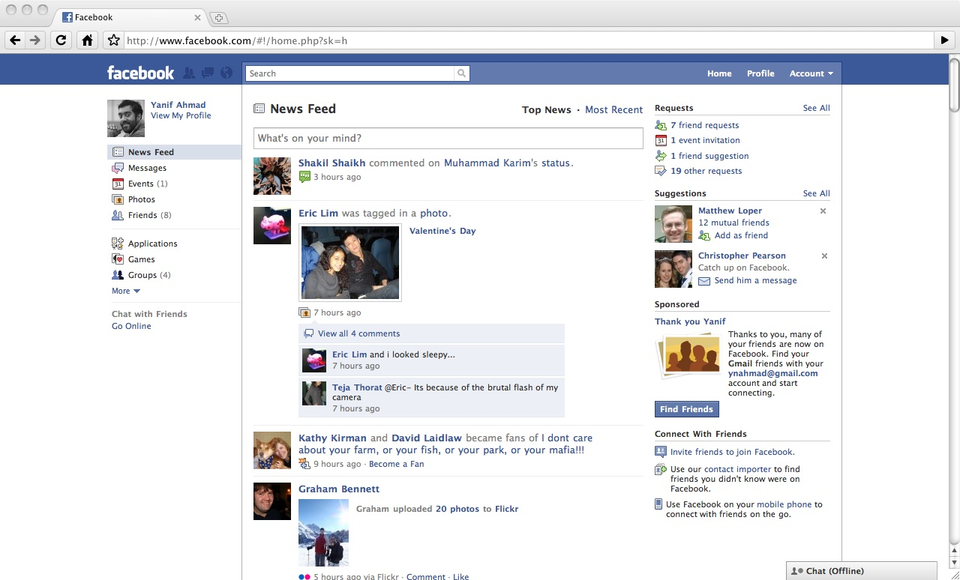
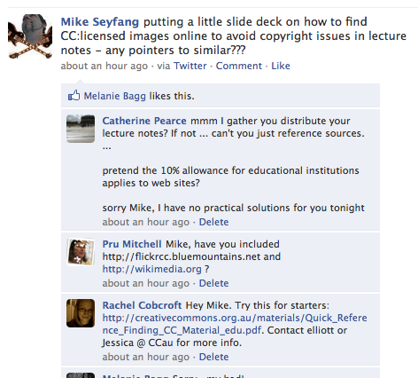
Apps in the 2010s: Microblogging, Personal Feeds
Facebook, Twitter streams
Status feed update examples:
Comments added to threads at any time
Posts removed from threads at any time
Queries:
Status analysis (e.g. to find hot trends)
Useful for advertising

Slide 14



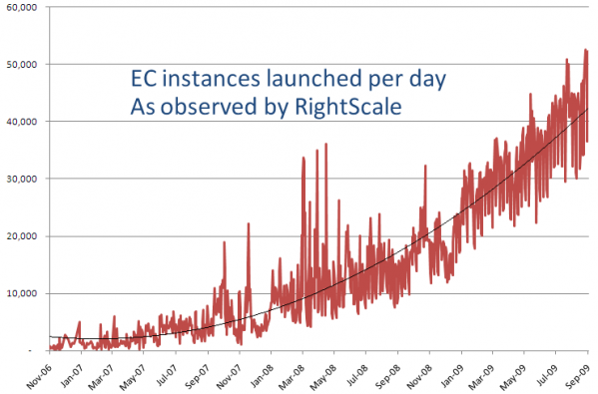
Apps in the 2010s: Cloud Management
Data management for cloud infrastructure metadata
Metadata updates:
VM / slice instantiation
and migration
Resource replenishment
and accountability
Queries:
Cloud monitoring
Billing queries

Slide 15
Update–Intensive Applications
These are all examples of update-heavy apps!
Algorithmic trading updates: order insertions & deletions
Microblogging updates: status updates, comments, edits
Cloud management updates: slice instantiation, migration
Other examples: moving objects, clickstream analysis
Relational databases are notoriously poor at handling updates
Update-intensive apps follow a recent trend, namely…
When commercial databases cannot handle app’s needs…
Notes:
Repeat sources of updates
Ripples
Read last bullet.

Slide 16
The Rise of Lightweight Databases
Communities avoid relational databases
Large web companies (Google, Amazon, eBay)
NoSQL crowd (Facebook, Digg)
Scientific applications (LHC/SLAC, NCAR/NOAA)
Communities roll their own lightweight systems
Trade off expressiveness and consistency for scalability
Many examples of this trend:
Streams: Streambase, IBM Infosphere Streams, MS StreamInsight
Analytics & cloud DBMS: mapreduce, Vertica, Greenplum, HadoopDB
Key-value stores: Bigtable, HBase, Dynamo
Notes:
Roll their own systems to scale out in both application dimensions and platform concerns
All in all, we’re seeing dm tools that are simpler, more specialized and more scalable.

Slide 17
The DBToaster Project
Project vision:
Develop techniques for generating nimble, robust, lightweight systems for data management applications
Reason about query properties from an online (i.e. incremental) perspective, to discover deep properties to exploit for scalability
Support an established declarative query language, establish that query evaluation can match hand-coded programs

Slide 18
Update Processing Example
Algorithmic trading schema
Bids(time, order_id, broker_id, price, volume)
Asks(time, order_id, broker_id, price, volume)
select sum((A.price*A.volume
– B.price*B.volume)
* (A.time – B.time))
as holds
from Bids B, Asks A
where B.broker_id = A.broker_id;

Slide 19

Update-Intensive Application Characteristics
Database must maintain results for continuous queries
Database must support arbitrary updates
select sum((A.price*A.volume
– B.price*B.volume) *
(A.time – B.time)) as holds
from Bids B, Asks A
where B.broker_id = A.broker_id;
t | oid | bid | p | v
5 | 4 | 2 | 100 | 50
3 | 2 | 1 | 90 | 100
7 | 6 | 1 | 70 | 25
t | oid | bid | p | v
6 | 5 | 2 | 105 | 70
2 | 1 | 1 | 110 | 60
4 | 3 | 1 | 115 | 50
holds
-325
?

Slide 20
Update-Intensive Application Characteristics
Database must maintain results for continuous queries
Database must support arbitrary updates
select sum((A.price*A.volume
– B.price*B.volume) *
(A.time – B.time)) as holds
from Bids B, Asks A
where B.broker_id = A.broker_id;
t | oid | bid | p | v
9 | 4 | 2 | 100 | 100
3 | 2 | 1 | 90 | 100
7 | 6 | 1 | 70 | 25
t | oid | bid | p | v
6 | 5 | 2 | 105 | 70
2 | 1 | 1 | 110 | 60
4 | 3 | 1 | 115 | 50
holds
-29150
?

Slide 21
Update-Intensive Application Characteristics
Database must maintain results for continuous queries
Database must support arbitrary updates
select sum((A.price*A.volume
– B.price*B.volume) *
(A.time – B.time)) as holds
from Bids B, Asks A
where B.broker_id = A.broker_id;
t | oid | bid | p | v
9 | 4 | 2 | 100 | 100
3 | 2 | 1 | 90 | 100
7 | 6 | 1 | 70 | 25
t | oid | bid | p | v
11 | 5 | 2 | 105 | 120
2 | 1 | 1 | 110 | 60
4 | 3 | 1 | 115 | 50
holds
-31900
?

Slide 22
Update-Intensive Application Characteristics
holds
-14500
Database must maintain results for continuous queries
Database must support arbitrary updates
∑
Plan-based techniques:
Naïve: repeat the query on the whole input, whenever it changes
⨝
State-of-the-art: view maintenance and stream processing
t | oid | bid | p | v
4 | 3 | 1 | 100 | 50
2 | 1 | 1 | 120 | 50
6 | 5 | 2 | 150 | 30
t | oid | bid | p | v
5 | 4 | 2 | 100 | 50
3 | 2 | 1 | 80 | 100
7 | 6 | 1 | 80 | 50

Slide 23
The State of the Art in Update Processing
Views: logical relations derived from a query’s results
Incremental view maintenance
Mechanism: delta queries
Simpler than view definition query
But… delta queries still processed with classical QP engine
holds
-14500
∑
Delta query
⨝
Base tables
Well-studied through 1980-today:
[Roussopoulos, 1991; Yan and Larson, 1995; Colby et al, 1996; Kotidis and Roussopoulos, 2001; Zhou et al, 2007]
t | oid | bid | p | v
5 | 4 | 2 | 100 | 50
3 | 2 | 1 | 80 | 100
7 | 6 | 1 | 80 | 50
t | oid | bid | p | v
4 | 3 | 1 | 100 | 50
2 | 1 | 1 | 120 | 50
6 | 5 | 2 | 150 | 30
Delta tables
Notes:
Goal: do minimal work given updates, avoid computation from scratch
No persistent intermediate data structures unless rewritten from another MV
Designed for batch processing & ad-hoc queries

Slide 24
The State of the Art in Update Processing
Views: logical relations derived from a query’s results
Incremental view maintenance
Mechanism: delta queries
Simpler than view definition query
But… delta queries still processed with classical QP engine
holds
-14500
∑
⨝
Delta query
8 | 4 | 2 | 100 | 100
Base tables
Well-studied through 1980-today:
[Roussopoulos, 1991; Yan and Larson, 1995; Colby et al, 1996; Kotidis and Roussopoulos, 2001; Zhou et al, 2007]
t | oid | bid | p | v
8 | 4 | 2 | 100 | 100
3 | 2 | 1 | 80 | 100
7 | 6 | 1 | 80 | 50
t | oid | bid | p | v
4 | 3 | 1 | 100 | 50
2 | 1 | 1 | 120 | 50
6 | 5 | 2 | 150 | 30
Delta tables
Notes:
Goal: do minimal work given updates, avoid computation from scratch
No persistent intermediate data structures unless rewritten from another MV
Designed for batch processing & ad-hoc queries

Slide 25
The State of the Art in Update Processing
Views: logical relations derived from a query’s results
Incremental view maintenance
Mechanism: delta queries
Simpler than view definition query
But… delta queries still processed with classical QP engine
holds
-14500
∑
⨝
Delta query
8 | 4 | 2 | 100 | 100
6 | 5 | 2 | 150 | 30
Base tables
Well-studied through 1980-today:
[Roussopoulos, 1991; Yan and Larson, 1995; Colby et al, 1996; Kotidis and Roussopoulos, 2001; Zhou et al, 2007]
t | oid | bid | p | v
8 | 4 | 2 | 100 | 100
3 | 2 | 1 | 80 | 100
7 | 6 | 1 | 80 | 50
t | oid | bid | p | v
4 | 3 | 1 | 100 | 50
2 | 1 | 1 | 120 | 50
6 | 5 | 2 | 150 | 30
Delta tables
Notes:
Goal: do minimal work given updates, avoid computation from scratch
No persistent intermediate data structures unless rewritten from another MV
Designed for batch processing & ad-hoc queries

Slide 26
The State of the Art in Update Processing
Views: logical relations derived from a query’s results
Incremental view maintenance
Mechanism: delta queries
Simpler than view definition query
But… delta queries still processed with classical QP engine
holds
-14500 +(-5000+1500+15000) =3000
∑
8 | 100 | 100
6 | 150 | 30
⨝
Delta query
8 | 4 | 2 | 100 | 100
6 | 5 | 2 | 150 | 30
Base tables
Well-studied through 1980-today:
[Roussopoulos, 1991; Yan and Larson, 1995; Colby et al, 1996; Kotidis and Roussopoulos, 2001; Zhou et al, 2007]
t | oid | bid | p | v
8 | 4 | 2 | 100 | 100
3 | 2 | 1 | 80 | 100
7 | 6 | 1 | 80 | 50
t | oid | bid | p | v
4 | 3 | 1 | 100 | 50
2 | 1 | 1 | 120 | 50
6 | 5 | 2 | 150 | 30
Delta tables
Notes:
Goal: do minimal work given updates, avoid computation from scratch
No persistent intermediate data structures unless rewritten from another MV
Designed for batch processing & ad-hoc queries

Slide 27
The State of the Art in Update Processing
Stream processing engines (SPEs)
Assumes append-only ordered inputs
Processes queries over windows of input data
Windows advance over the input stream, with results produced for each window
Window
t | oid | bid | p | v
1 | 1 | 2 | 90 | 25
2 | 2 | 1 | 50 | 40
3 | 3 | 2 | 40 | 80
4 | 2 | 1 | 60 | 100
5 | 4 | 2 | 100 | 50
6 | 6 | 1 | 80 | 50
7 | 2 | 1 | 80 | 100
t=1
t | sum(v)
1 | 145
Notes:
Windows are contiguous sequences of inputs
Fundamentally designed for sequence and time-series processing, doesn’t deal well with gaps etc.

Slide 28
The State of the Art in Update Processing
Stream processing engines (SPEs)
Assumes append-only ordered inputs
Processes queries over windows of input data
Windows advance over the input stream, with results produced for each window
t | oid | bid | p | v
1 | 1 | 2 | 90 | 25
2 | 2 | 1 | 50 | 40
3 | 3 | 2 | 40 | 80
4 | 2 | 1 | 60 | 100
5 | 4 | 2 | 100 | 50
6 | 6 | 1 | 80 | 50
7 | 2 | 1 | 80 | 100
t=2
t | sum(v)
1 | 145
2 | 220
Notes:
Windows are contiguous sequences of inputs
Fundamentally designed for sequence and time-series processing, doesn’t deal well with gaps etc.

Slide 29
The State of the Art in Update Processing
Stream processing engines (SPEs)
Assumes append-only ordered inputs
Processes queries over windows of input data
Windows advance over the input stream, with results produced for each window
t | oid | bid | p | v
1 | 1 | 2 | 90 | 25
2 | 2 | 1 | 50 | 40
3 | 3 | 2 | 40 | 80
4 | 2 | 1 | 60 | 100
5 | 4 | 2 | 100 | 50
6 | 6 | 1 | 80 | 50
7 | 2 | 1 | 80 | 100
t=3
t | sum(v)
1 | 145
2 | 220
3 | 230
Notes:
Windows are contiguous sequences of inputs
Fundamentally designed for sequence and time-series processing, doesn’t deal well with gaps etc.

Slide 30
The State of the Art in Update Processing
Stream processing engines (SPEs)
Assumes append-only ordered inputs
Processes queries over windows of input data
Windows advance over the input stream, with results produced for each window
t | oid | bid | p | v
1 | 1 | 2 | 90 | 25
2 | 2 | 1 | 50 | 40
3 | 3 | 2 | 40 | 80
4 | 2 | 1 | 60 | 100
5 | 4 | 2 | 100 | 50
6 | 6 | 1 | 80 | 50
7 | 2 | 1 | 80 | 100
t=4
t | sum(v)
1 | 145
2 | 220
3 | 230
4 | 200
Notes:
Windows are contiguous sequences of inputs
Fundamentally designed for sequence and time-series processing, doesn’t deal well with gaps etc.

Slide 31
The State of the Art in Update Processing
Stream processing engines (SPEs)
Assumes append-only ordered inputs
Processes queries over windows of input data
Windows advance over the input stream, with results produced for each window
t | oid | bid | p | v
1 | 1 | 2 | 90 | 25
2 | 2 | 1 | 50 | 40
3 | 3 | 2 | 40 | 80
4 | 2 | 1 | 60 | 100
5 | 4 | 2 | 100 | 50
6 | 6 | 1 | 80 | 50
7 | 2 | 1 | 80 | 100
t=5
t | sum(v)
1 | 145
2 | 220
3 | 230
4 | 200
5 | 200
Notes:
Windows are contiguous sequences of inputs
Fundamentally designed for sequence and time-series processing, doesn’t deal well with gaps etc.

Slide 32
The State of the Art in Update Processing
Stream processing engines (SPEs)
Assumes append-only ordered inputs
Processes queries over windows of input data
Windows advance over the input stream, with results produced for each window
Windows are specified per query operator, and maintained as data structures in each operator
Mechanism: window-based operators
Incrementally processed for overlaps when windows slide
holds
14500
∑
⨝
t | oid | bid | p | v
5 | 4 | 2 | 100 | 50
7 | 2 | 1 | 80 | 100
6 | 6 | 1 | 80 | 50
t | oid | bid | p | v
4 | 3 | 1 | 100 | 50
5 | 1 | 1 | 120 | 50
6 | 5 | 2 | 150 | 30
Notes:
Windows are contiguous sequences of inputs
Fundamentally designed for sequence and time-series processing, doesn’t deal well with gaps etc.

Slide 33
The State of the Art in Update Processing
Stream processing engines (SPEs)
Assumes append-only ordered inputs
Processes queries over windows of input data
Windows advance over the input stream, with results produced for each window
Windows are specified per query operator, and maintained as data structures in each operator
Mechanism: window-based operators
Incrementally processed for overlaps when windows slide
holds
14500
∑
⨝
t | oid | bid | p | v
5 | 4 | 2 | 100 | 50
7 | 2 | 1 | 80 | 100
6 | 6 | 1 | 80 | 50
t | oid | bid | p | v
4 | 3 | 1 | 100 | 50
5 | 1 | 1 | 120 | 50
6 | 5 | 2 | 150 | 30
overlap
Notes:
Windows are contiguous sequences of inputs
Fundamentally designed for sequence and time-series processing, doesn’t deal well with gaps etc.

Slide 34
The State of the Art in Update Processing
Stream processing is unsuitable for update-intensive apps
holds
14500
∑
⨝
t | oid | bid | p | v
5 | 4 | 2 | 100 | 50
7 | 2 | 1 | 80 | 100
6 | 6 | 1 | 80 | 50
t | oid | bid | p | v
4 | 3 | 1 | 100 | 50
5 | 1 | 1 | 120 | 50
6 | 5 | 2 | 150 | 30

Slide 35
The State of the Art in Update Processing
Stream processing is unsuitable for update-intensive apps
holds
?
∑
⨝
t | oid | bid | p | v
5 | 4 | 2 | 100 | 50
9 | 2 | 1 | 80 | 80
6 | 6 | 1 | 80 | 50
t | oid | bid | p | v
4 | 3 | 1 | 100 | 50
8 | 1 | 1 | 120 | 100
6 | 5 | 2 | 150 | 30

Slide 36
The State of the Art in Update Processing
Stream processing is unsuitable for update-intensive apps
holds
?
∑
⨝
No window can enclose all updates
t | oid | bid | p | v
5 | 4 | 2 | 100 | 50
9 | 2 | 1 | 80 | 80
6 | 6 | 1 | 80 | 50
t | oid | bid | p | v
4 | 3 | 1 | 100 | 50
8 | 1 | 1 | 120 | 100
6 | 5 | 2 | 150 | 30

Slide 37
The State of the Art in Update Processing
Stream processing is unsuitable for update-intensive apps
Windows do not decouple data scoping and data manipulation
holds
?
∑
⨝
No window can enclose all updates
t | oid | bid | p | v
5 | 4 | 2 | 100 | 50
9 | 2 | 1 | 80 | 80
6 | 6 | 1 | 80 | 50
t | oid | bid | p | v
4 | 3 | 1 | 100 | 50
8 | 1 | 1 | 120 | 100
6 | 5 | 2 | 150 | 30

Slide 38
The State of the Art in Update Processing
Stream processing is unsuitable for update-intensive apps
Windows do not decouple data scoping and data manipulation
No “state-of-the-world” queries
No OLAP or nested aggregates
For general processing, stream engines resort to repetition
holds
?
∑
⨝
No window can enclose all updates
t | oid | bid | p | v
5 | 4 | 2 | 100 | 50
9 | 2 | 1 | 80 | 80
6 | 6 | 1 | 80 | 50
t | oid | bid | p | v
4 | 3 | 1 | 100 | 50
8 | 1 | 1 | 120 | 100
6 | 5 | 2 | 150 | 30

Slide 39
The State of the Art in Update Processing
holds
?
Incremental view maintenance
holds
-14500
Stream processing
∑
∑
Delta query
⨝
⨝
Base tables
t | oid | bid | p | v
5 | 4 | 2 | 100 | 50
3 | 2 | 1 | 80 | 100
7 | 6 | 1 | 80 | 50
t | oid | bid | p | v
4 | 3 | 1 | 100 | 50
2 | 1 | 1 | 120 | 50
6 | 5 | 2 | 150 | 30
t | oid | bid | p | v
5 | 4 | 2 | 100 | 50
9 | 2 | 1 | 80 | 80
6 | 6 | 1 | 80 | 50
t | oid | bid | p | v
4 | 3 | 1 | 100 | 50
8 | 1 | 1 | 120 | 100
6 | 5 | 2 | 150 | 30

Slide 40
DBToaster: Technical Focus of This Talk
“How do we efficiently, incrementally, process queries on a rapidly-changing, general, database?”
Notes:
… and how can we build a lightweight query processor for update-intensive applications

Slide 41
DBToaster: Technical Focus of This Talk
“How do we efficiently, incrementally, process queries on a rapidly-changing, general, database?”
holds
14900
select sum((B.price*B.volume
– A.price*A.volume)
* (B.time – A.time))
from Bids B, Asks A
where B.broker_id = A.broker_id;
Map datastructures
t | oid | bid | p | v
5 | 4 | 2 | 100 | 50
9 | 2 | 1 | 80 | 80
6 | 6 | 1 | 80 | 50
t | oid | bid | p | v
4 | 3 | 1 | 100 | 50
8 | 1 | 1 | 120 | 100
6 | 5 | 2 | 150 | 30

Slide 42
DBToaster: Our Results
Extremely efficient, lightweight incremental query evaluation
Datastructure-oriented, not operator-oriented
For many practical queries, we evaluate queries asymptotically faster than any non-incremental algorithm
e.g. 2-way join & aggregate query in linear time!
Embarrassingly parallelizable
Novel algorithm to compile SQL to this evaluation model
extends the class of queries that can be processed incrementally

Slide 43
Talk Outline
Introduction and background
A simple intermediate language: M3
Can be evaluated in constant time
Extremely parallelizable
Compiling SQL aggregate queries to M3
Aggressive recursive compilation
Experimental evaluation against commercial DBMS
Parallel evaluation of M3 programs
Large-scale main-memory OLAP M3 runtime
Research summary and future work
Numerical query processing
M3
DBToaster
Cumulus

Slide 44
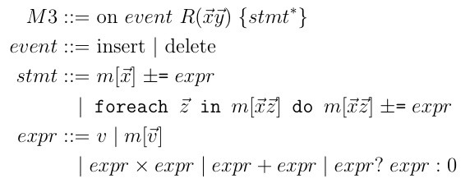
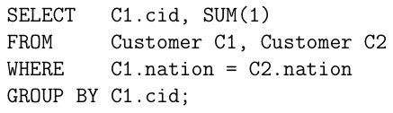
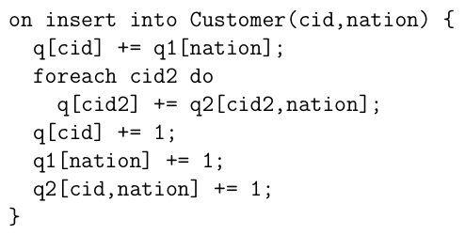
M3: Map Maintenance Intermediate Language
Trigger statements
Slice update statements
Arithmetic map expressions

Slide 45
M3: Map Maintenance Intermediate Language
Trigger statements
Slice update statements
Arithmetic map expressions
Auxiliary maps:
q1: # customers per nation
q2: # customer, nation pairs

Slide 46
M3: Evaluation Example
Δq1
q1[US]+=1
q1[UK]+=1
q1[UK]+=1
q1[US]+=1
q1[UK]-=1
q1[US]+=1
Trigger
Map: q1
Map: q2
Map: q
Trace: q
t |  | ΔC
nation
cid | nation
cid
Δq
Δq2
q2[1,US] += 1
q2[2,UK] += 1
q2[3,UK] += 1
q2[4,US]+=1
q2[3,UK]-=1
q2[3,US]+=1

Slide 47
M3: Evaluation Example
Δq1
q1[US]+=1
q1[UK]+=1
q1[UK]+=1
q1[US]+=1
q1[UK]-=1
q1[US]+=1
Trigger
Map: q1
Map: q2
Map: q
Trace: q
t |  | ΔC
1 | + | 1,US
nation
cid | nation
cid
1 | 1
Δq
q[1] += 1
Δq2
q2[1,US] += 1
q2[2,UK] += 1
q2[3,UK] += 1
q2[4,US]+=1
q2[3,UK]-=1
q2[3,US]+=1

Slide 48
M3: Evaluation Example
Δq1
q1[US]+=1
q1[UK]+=1
q1[UK]+=1
q1[US]+=1
q1[UK]-=1
q1[US]+=1
Trigger
Map: q1
Map: q2
Map: q
Trace: q
t |  | ΔC
1 | + | 1,US
nation
US | 1
cid | nation
1 | US | 1
cid
1 | 1
Δq
q[1] += 1
Δq2
q2[1,US] += 1
q2[2,UK] += 1
q2[3,UK] += 1
q2[4,US]+=1
q2[3,UK]-=1
q2[3,US]+=1

Slide 49
M3: Evaluation Example
Δq1
q1[US]+=1
q1[UK]+=1
q1[UK]+=1
q1[US]+=1
q1[UK]-=1
q1[US]+=1
Trigger
Map: q1
Map: q2
Map: q
Trace: q
t |  | ΔC
1 | + | 1,US
nation
US | 1
cid | nation
1 | US | 1
cid
1 | 1
Δq
q[1] += 1
Δq2
q2[1,US] += 1
q2[2,UK] += 1
q2[3,UK] += 1
q2[4,US]+=1
q2[3,UK]-=1
q2[3,US]+=1

Slide 50
M3: Evaluation Example
Δq1
q1[US]+=1
q1[UK]+=1
q1[UK]+=1
q1[US]+=1
q1[UK]-=1
q1[US]+=1
Trigger
Map: q1
Map: q2
Map: q
Trace: q
t |  | ΔC
1 | + | 1,US
2 | + | 2,UK
nation
US | 1
cid | nation
1 | US | 1
cid
1 | 1
2 | 1
Δq
q[1] += 1
q[2] += 1
Δq2
q2[1,US] += 1
q2[2,UK] += 1
q2[3,UK] += 1
q2[4,US]+=1
q2[3,UK]-=1
q2[3,US]+=1

Slide 51
M3: Evaluation Example
Δq1
q1[US]+=1
q1[UK]+=1
q1[UK]+=1
q1[US]+=1
q1[UK]-=1
q1[US]+=1
Trigger
Map: q1
Map: q2
Map: q
Trace: q
t |  | ΔC
1 | + | 1,US
2 | + | 2,UK
3 | + | 3.UK
nation
US | 1
UK | 1
cid | nation
1 | US | 1
2 | UK | 1
cid
1 | 1
2 | 2
3 | 2
Δq
q[1] += 1
q[2] += 1
q[3] += q1[UK] + 1 q[2] += q2[2,UK]
Δq2
q2[1,US] += 1
q2[2,UK] += 1
q2[3,UK] += 1
q2[4,US]+=1
q2[3,UK]-=1
q2[3,US]+=1

Slide 52
M3: Evaluation Example
Δq1
q1[US]+=1
q1[UK]+=1
q1[UK]+=1
q1[US]+=1
q1[UK]-=1
q1[US]+=1
Trigger
Map: q1
Map: q2
Map: q
Trace: q
t |  | ΔC
1 | + | 1,US
2 | + | 2,UK
3 | + | 3.UK
nation
US | 1
UK | 1
cid | nation
1 | US | 1
2 | UK | 1
cid
1 | 1
2 | 2
3 | 2
Δq
q[1] += 1
q[2] += 1
q[3] += q1[UK] + 1 q[2] += q2[2,UK]
Δq2
q2[1,US] += 1
q2[2,UK] += 1
q2[3,UK] += 1
q2[4,US]+=1
q2[3,UK]-=1
q2[3,US]+=1

Slide 53
M3: Evaluation Example
Δq1
q1[US]+=1
q1[UK]+=1
q1[UK]+=1
q1[US]+=1
q1[UK]-=1
q1[US]+=1
Trigger
Map: q1
Map: q2
Map: q
Trace: q
t |  | ΔC
1 | + | 1,US
2 | + | 2,UK
3 | + | 3.UK
4 | + | 4,US
nation
US | 1
UK | 2
cid | nation
1 | US | 1
2 | UK | 1
3 | UK | 1
cid
1 | 2
2 | 2
3 | 2
4 | 2
Δq
q[1] += 1
q[2] += 1
q[3] += q1[UK] + 1 q[2] += q2[2,UK]
q[4] += q1[US] + 1 q[1] += q2[1,US]
Δq2
q2[1,US] += 1
q2[2,UK] += 1
q2[3,UK] += 1
q2[4,US]+=1
q2[3,UK]-=1
q2[3,US]+=1

Slide 54
M3: Evaluation Example
Δq1
q1[US]+=1
q1[UK]+=1
q1[UK]+=1
q1[US]+=1
q1[UK]-=1
q1[US]+=1
Trace: q
Trigger
Map: q1
Map: q2
Map: q
Δq
q[1] += 1
q[2] += 1
q[3] += q1[UK] + 1 q[2] += q2[2,UK]
q[4] += q1[US] + 1 q[1] += q2[1,US]
q[3] -= q1[UK] - 1 q[2] -= q2[2,UK]
t |  | ΔC
1 | + | 1,US
2 | + | 2,UK
3 | + | 3.UK
4 | + | 4,US
5 | - | 3,UK
nation
US | 2
UK | 2
cid | nation
1 | US | 1
2 | UK | 1
3 | UK | 1
4 | US | 1
cid
1 | 2
2 | 1
3 | 0
4 | 2
Δq2
q2[1,US] += 1
q2[2,UK] += 1
q2[3,UK] += 1
q2[4,US]+=1
q2[3,UK]-=1
q2[3,US]+=1

Slide 55
M3: Evaluation Example
Δq1
q1[US]+=1
q1[UK]+=1
q1[UK]+=1
q1[US]+=1
q1[UK]-=1
q1[US]+=1
Trace: q
Δq
q[1] += 1
q[2] += 1
q[3] += q1[UK] + 1 q[2] += q2[2,UK]
q[4] += q1[US] + 1 q[1] += q2[1,US]
q[3] -= q1[UK] - 1 q[2] -= q2[2,UK]
q[3] += q1[US] + 1 q[1] += q2[1,US] q[4] += q2[4,US]
Trigger
Map: q1
Map: q2
Map: q
t |  | ΔC
1 | + | 1,US
2 | + | 2,UK
3 | + | 3.UK
4 | + | 4,US
5 | - | 3,UK
6 | + | 3,US
nation
US | 2
UK | 1
cid | nation
1 | US | 1
2 | UK | 1
3 | UK | 0
4 | US | 1
cid
1 | 3
2 | 1
3 | 3
4 | 3
Δq2
q2[1,US] += 1
q2[2,UK] += 1
q2[3,UK] += 1
q2[4,US]+=1
q2[3,UK]-=1
q2[3,US]+=1

Slide 56
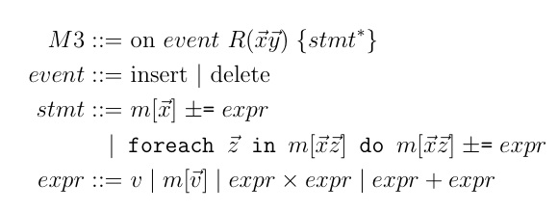
M3: Map Maintenance Intermediate Language
No operators, only map updates
Constant time expressions (RHS), i.e. maintain each aggregate value in constant time!
Other structural characteristics:
Topologically sorted w.r.t map updates (statements use “old” data)
“Atomic” triggers

Slide 57
Query Compilation
DBToaster compiles SQL group-by aggregate queries
Queries specified on an arbitrary database as with views
DBToaster uses aggressive recursive compilation
Compute deltas of queries as in incremental view maintenance.
But: the delta is again a query: so maintain its view incrementally by delta processing.
Maintain the delta to the delta incrementally, etc.
Delta processing rules are an analogy to differentials in calculus, but applied to relational calculus.
Related work: System R [Chamberlin et al. ‘81], Genesis [Batory et al. ‘88]

Slide 58
Example Schema (~TPC-H)
q[] = select sum(LI.P * O.XCH)
from Order O, LineItem LI
where O.OK = LI.OK;
Order(OrderKey, CustomerKey, Date, ExchangeRate)
O(OK, CK, D, XCH)
LineItem(OrderKey, PartKey, Price)
LI(OK, PK, P)

Slide 59
Example Schema (~TPC-H)
q[] = select sum(LI.P * O.XCH)
from Order O, LineItem LI
where O.OK = LI.OK;
select sum((A.price – B.price)
* (A.time – B.time))
as holds
from Bids B, Asks A
where B.broker_id = A.broker_id;
Order(OrderKey, CustomerKey, Date, ExchangeRate)
O(OK, CK, D, XCH)
LineItem(OrderKey, PartKey, Price)
LI(OK, PK, P)

Slide 60
Compilation Example
q[] = select sum(LI.P * O.XCH)
from Order O, LineItem LI
where O.OK = LI.OK;

Slide 61
Compilation Example
q[] = select sum(LI.P * O.XCH)
from Order O, LineItem LI
where O.OK = LI.OK;
+O(xOK, xCK, xD, xXCH) q[] +=
select sum(LI.P * O.XCH)
from {<xOK, xCK, xD, xXCH>} O, LineItem LI
where O.OK = LI.OK;
+LI(yOK, yPK, yP) q[] += ...
Notes:
Eliminate variables, by unification

Slide 62
Compilation Example
q[] = select sum(LI.P * O.XCH)
from Order O, LineItem LI
where O.OK = LI.OK;
+O(xOK, xCK, xD, xXCH) q[] +=
select sum(LI.P * xXCH)
from LineItem LI
where xOK = LI.OK;
+LI(yOK, yPK, yP) q[] += ...

Slide 63
Compilation Example
q[] = select sum(LI.P * O.XCH)
from Order O, LineItem LI
where O.OK = LI.OK;
+O(xOK, xCK, xD, xXCH) q[] += xXCH *
select sum(LI.P)
from LineItem LI qO[xOK]
where xOK = LI.OK;
+LI(yOK, yPK, yP) q[] += ...
Notes:
Extract aggregates, which defines maps. Note parameter xOK

Slide 64
Compilation Example
q[] = select sum(LI.P * O.XCH)
from Order O, LineItem LI
where O.OK = LI.OK;
+O(xOK, xCK, xD, xXCH) q[] += xXCH * qO[xOK];
foreach xOK: qO[xOK] =
select sum(LI.P)
from LineItem LI
where xOK = LI.OK;
+LI(yOK, yPK, yP) q[] += ...
Notes:
Each map has a defining query. In the general definition of a map, we don’t have any constraints on parameters, thus we have to reason about them for all parameter values.
So for what values of xOK do we need to maintain q0, i.e. what values will we see? These are defined by the relations O and LI, i.e. the active domain
Two cases: one where other triggers, such as LI extend the active domain of xOK, and when the trigger for +O does a lookup with a new value for xOK.

Slide 65
Compilation Example
q[] = select sum(LI.P * O.XCH)
from Order O, LineItem LI
where O.OK = LI.OK;
+O(xOK, xCK, xD, xXCH) q[] += xXCH * qO[xOK];
+LI(yOK, yPK, yP) foreach xOK: qO[xOK] +=
select sum(LI.P)
from {<yOK, yPK, yP>} LI
where xOK = LI.OK;
+LI(yOK, yPK, yP) q[] += ...

Slide 66
Compilation Example
q[] = select sum(LI.P * O.XCH)
from Order O, LineItem LI
where O.OK = LI.OK;
+O(xOK, xCK, xD, xXCH) q[] += xXCH * qO[xOK];
+LI(yOK, yPK, yP) foreach xOK: qO[xOK] +=
select yP
where xOK = yOK;
+LI(yOK, yPK, yP) q[] += ...

Slide 67
Compilation Example
q[] = select sum(LI.P * O.XCH)
from Order O, LineItem LI
where O.OK = LI.OK;
+O(xOK, xCK, xD, xXCH) q[] += xXCH * qO[xOK];
+LI(yOK, yPK, yP) qO[yOK] += yP;
+LI(yOK, yPK, yP) q[] += ...

Slide 68
Compilation Example
q[] = select sum(LI.P * O.XCH)
from Order O, LineItem LI
where O.OK = LI.OK;
+O(xOK, xCK, xD, xXCH) q[] += xXCH * qO[xOK];
+LI(yOK, yPK, yP) qO[yOK] += yP;
+LI(yOK, yPK, yP) q[] +=
select sum(LI.P * O.XCH)
from Order O, {<yOK, yPK, yP>} LI
where O.OK = LI.OK;

Slide 69
Compilation Example
q[] = select sum(LI.P * O.XCH)
from Order O, LineItem LI
where O.OK = LI.OK;
+O(xOK, xCK, xD, xXCH) q[] += xXCH * qO[xOK];
+LI(yOK, yPK, yP) qO[yOK] += yP;
+LI(yOK, yPK, yP) q[] +=
select sum( yP * O.XCH)
from Order O
where O.OK = yOK;

Slide 70
Compilation Example
q[] = select sum(LI.P * O.XCH)
from Order O, LineItem LI
where O.OK = LI.OK;
+O(xOK, xCK, xD, xXCH) q[] += xXCH * qO[xOK];
+LI(yOK, yPK, yP) qO[yOK] += yP;
+LI(yOK, yPK, yP) q[] += yP *
select sum( O.XCH)
from Order O
where O.OK = yOK;

Slide 71
Compilation Example
q[] = select sum(LI.P * O.XCH)
from Order O, LineItem LI
where O.OK = LI.OK;
+O(xOK, xCK, xD, xXCH) q[] += xXCH * qO[xOK];
+LI(yOK, yPK, yP) qO[yOK] += yP;
+LI(yOK, yPK, yP) q[] += yP * qLI[yOK];
select sum( O.XCH)
from Order O qLI[yOK]
where O.OK = yOK;

Slide 72
Compilation Example
q[] = select sum(LI.P * O.XCH)
from Order O, LineItem LI
where O.OK = LI.OK;
+O(xOK, xCK, xD, xXCH) q[] += xXCH * qO[xOK];
+LI(yOK, yPK, yP) qO[yOK] += yP;
+LI(yOK, yPK, yP) q[] += yP * qLI[yOK];
+O(xOK, xCK, xD, xXCH) foreach yOK: qLI[yOK] +=
select sum( O.XCH)
from {<xOK, xCK, xD, xXCH>} O
where O.OK = yOK;

Slide 73
Compilation Example
q[] = select sum(LI.P * O.XCH)
from Order O, LineItem LI
where O.OK = LI.OK;
+O(xOK, xCK, xD, xXCH) q[] += xXCH * qO[xOK];
+LI(yOK, yPK, yP) qO[yOK] += yP;
+LI(yOK, yPK, yP) q[] += yP * qLI[yOK];
+O(xOK, xCK, xD, xXCH) foreach yOK: qLI[yOK] +=
select xXCH
where xOK = yOK;

Slide 74
Compilation Example
q[] = select sum(LI.P * O.XCH)
from Order O, LineItem LI
where O.OK = LI.OK;
+O(xOK, xCK, xD, xXCH) q[] += xXCH * qO[xOK];
+LI(yOK, yPK, yP) qO[yOK] += yP;
+LI(yOK, yPK, yP) q[] += yP * qLI[yOK];
+O(xOK, xCK, xD, xXCH) qLI[xOK] += xXCH;
The triggers for incrementally maintaining all the maps run in constant time!

Slide 75
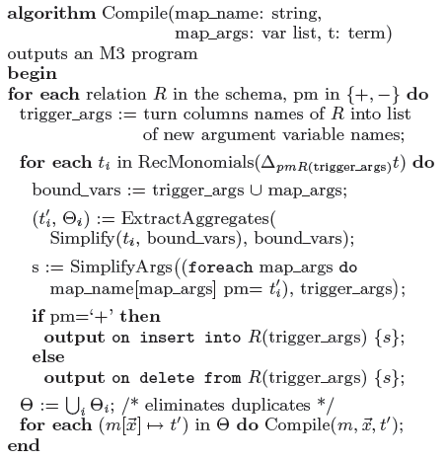
Compilation Algorithm
Given a query Q,
Compute delta of Q for tuple insertion/deletion.
Simplify delta query.
Extract aggregate queries.
Recursively compile extracted aggregate subqueries.

Slide 76
Nested Aggregate Queries
select avg(b0.p * b0.v) from B b0
where 0.25 * (select sum(b1.v) from B b1) >
(select sum(b2.v) from B b2
where b2.p > b0.p);
+B(xp, xv): q[] += sum_p(
if (c[p] + Delta c[p] > 0) then Delta a[p] else 0
+ if (c[p] + Delta c[p] > 0) and (c[p] <= 0)
then a[p] else 0
- if (c[p] + Delta c[p] <= 0) and (c[p] > 0)
then a[p] else 0)
Delta c[p] = 0.25 * xv – (if (xp > p) then xv else 0)
Delta a[p] = if (xp = p) then xp * xv else 0

Slide 77
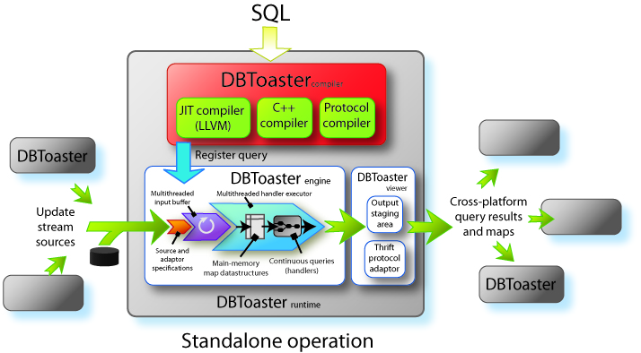
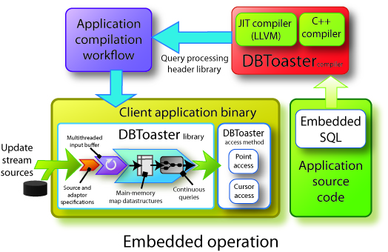
DBToaster Stream Engine
QPs as shared libraries
Queries run in the same process space as app
JIT compilation of queries with LLVM
Protocol compiler based on Apache Thrift

Slide 78
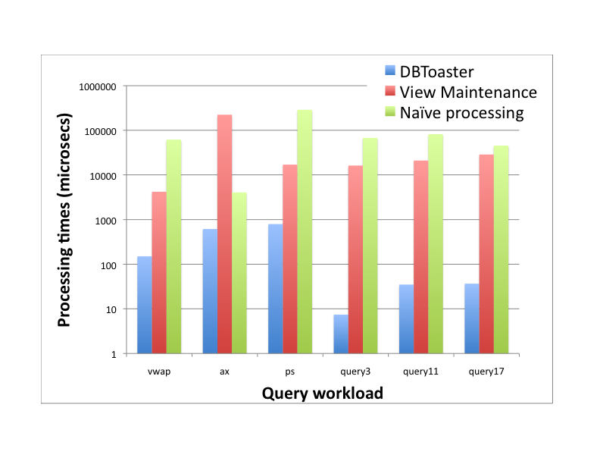
Experiments: QP Performance
Workload: i) order book queries: vwap, ax, ps. ii) TPC-H: query3, query11, query17
Datasets:
NASDAQ ITCH, Dec 08-Feb 09
TPC-H, scale factor 1
Takeaways:
1-2 orders of magnitude speedup on order book queries
2.5-4 orders of magnitude speedup on TPC-H
Order book queries have a more complex nesting structure

Slide 79
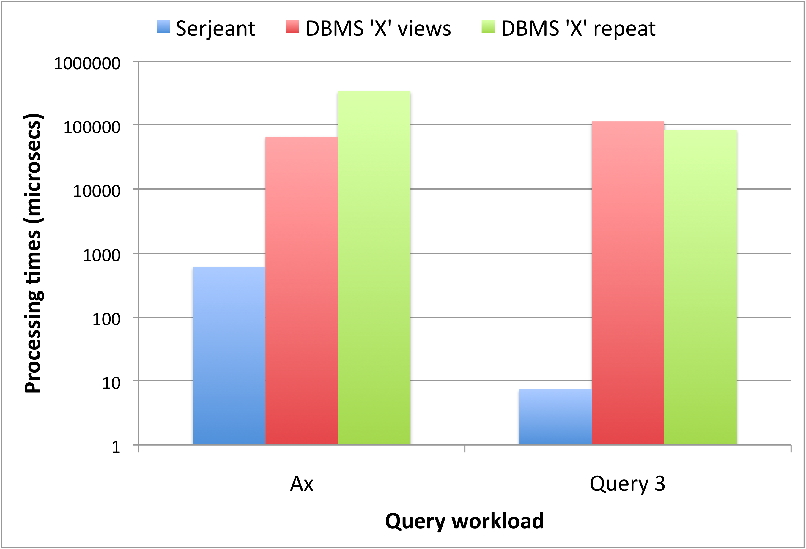
Experiments: DBMS comparison
DBToaster vs. commercial DBMS (‘X’) that supports incremental view maintenance:
DBMS ‘X’ views: incremental view maintenance
DBMS ‘X’ repeat: from-scratch maintenance
DBMS ‘X’ supports maintenance of only two queries incrementally
DBToaster yields 2.5-4 orders of magnitude speedup
DBToaster

Slide 80
Query Compilation: Takeaways
DBToaster uses aggressive recursive compilation
Datastructure-oriented query evaluation
Supports incremental computation of nested aggregate queries
DBToaster yields 2.5-4 orders of magnitude speedup over a commercial DBMS ‘X’
Now we’ll see added benefits of datastructure-based evaluation…

Slide 81
App: Massively Parallel Real-time OLAP
OLAP cubes: multidimensional group-by aggregates
Heavily used for business intelligence
Traditionally processed on different DBMS architecture to OLTP
Much of the work on databases in the cloud targets similar functionality
Target stores
select c.customer_id, month(o.date)
sum(orders.price)
from customers c, orders o
where c.customer_id = o.customer_id
group by c.customer_id, month(o.date)

Slide 82
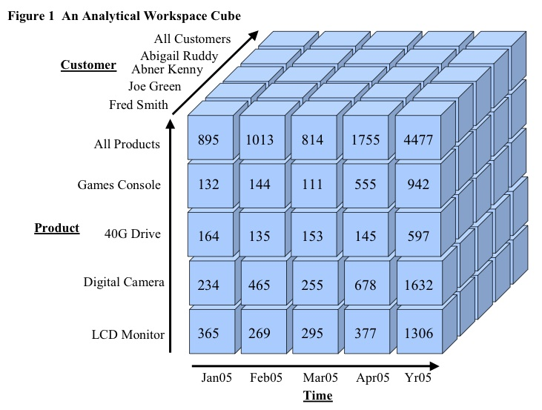
App: Massively Parallel Real-time OLAP
OLAP cubes: multidimensional group-by aggregates
Heavily used for business intelligence
Traditionally processed on different DBMS architecture to OLTP
Much of the work on databases in the cloud targets similar functionality
Continuous OLAP maintains subset of cube entries
Use DBToaster to compile aggregate queries for entries, sharing maps
Scalability challenges:
Large # of dimensions & labels, large maps
High-throughput parallel M3 processing
Responsiveness under heavy update rates

Slide 83
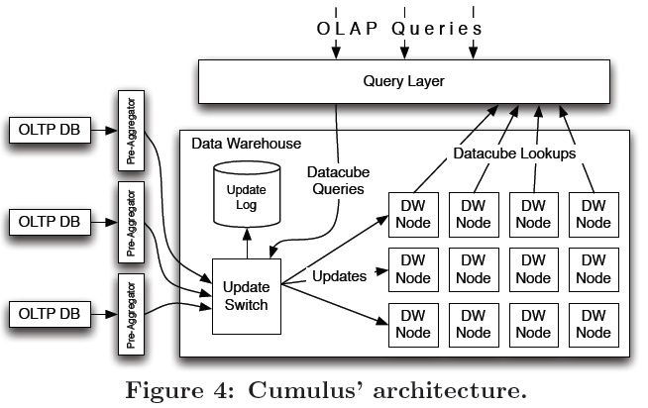
Cumulus: a Distributed M3 Engine
Cumulus is a distributed shared-nothing interpreter for running DBToaster code, used for an online main-memory OLAP system.
Exploits that M3 programs admit embarrassingly parallel evaluation
Each map value requires only a constant amount of work to update!
Insight: evaluate M3 programs in terms of multidimensional map slices

Slide 84
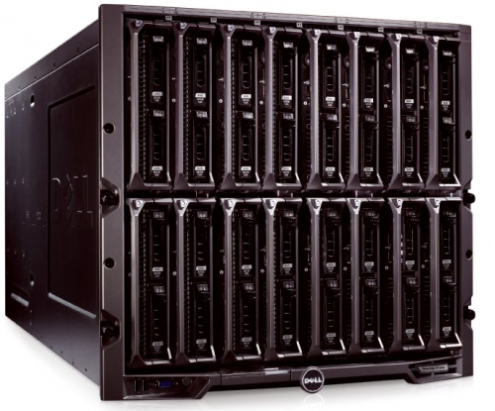
Parallelizing M3 Programs
Maintaining individual aggregates
Message flow & types
put(dest, src, stmt, barrier)
Switch
Update
stream
Map
write
nation
US
UK
China
India
US
UK
fetch(dest, src, xfers)
Map
reads
push(dest, src, entries)
China
India

Slide 85
M3 Processing Protocol
DBToaster code snippet:
on insert PART(pk,retailprice,desc,…)
{
…
foreach nk in m1:
m1[nk] += retailprice * m2[pk,nk] – m3[pk,nk];
…
}
Map partitions in a cluster:
N1: m1[Europe]
m2[car parts,*]
N2: m1[Americas]
m3[bike parts,*]
N1
N2
N3
N4
N4: m1[Africa]
m3[car parts,*]
N3: m1[Asia]
m2[bike parts,*]

Slide 86
M3 Processing Protocol
DBToaster code snippet:
Map partitions in a cluster:
on insert
PART(pk,retailprice,desc,…)
{
…
foreach nk in m1:
m1[nk] += retailprice *
m2[pk,nk] – m3[pk,nk];
…
}
N1: m1[Europe]
m2[car parts,*]
N2: m1[Americas]
m3[bike parts,*]
N1
N2
N3: m1[Asia]
m2[bike parts,*]
N4: m1[Africa]
m3[car parts,*]
N3
N4
Event: +PART(21,$500, ‘timing belt’)
Switch
N1
N2
N3
N4

Slide 87
M3 Processing Protocol
DBToaster code snippet:
Map partitions in a cluster:
on insert
PART(pk,retailprice,desc,…)
{
…
foreach nk in m1:
m1[nk] += retailprice *
m2[pk,nk] – m3[pk,nk];
…
}
N1: m1[Europe]
m2[car parts,*]
N2: m1[Americas]
m3[bike parts,*]
N1
N2
N3: m1[Asia]
m2[bike parts,*]
N4: m1[Africa]
m3[car parts,*]
N3
N4
Event: +PART(21,$500, ‘timing belt’)
Switch messages:
Switch
FETCH(N1,m2[21,*]=>
{N1,N2,N3,N4})
FETCH(N4,m3[21,*]=>
{N1,N2,N3,N4})
PUT({N1,N2,N3,N4},
m1[x]+=
m2[21,x]*m3[21,x],
{N1,N4})
N1
N2
N3
N4
Fetch

Slide 88
M3 Processing Protocol
DBToaster code snippet:
Map partitions in a cluster:
on insert
PART(pk,retailprice,desc,…)
{
…
foreach nk in m1:
m1[nk] += retailprice *
m2[pk,nk] – m3[pk,nk];
…
}
N1: m1[Europe]
m2[car parts,*]
N2: m1[Americas]
m3[bike parts,*]
N1
N2
N3: m1[Asia]
m2[bike parts,*]
N4: m1[Africa]
m3[car parts,*]
N3
N4
Event: +PART(21,$500, ‘timing belt’)
Switch messages:
Switch
FETCH(N1,m2[21,*]=>
{N1,N2,N3,N4})
FETCH(N4,m3[21,*]=>
{N1,N2,N3,N4})
PUT({N1,N2,N3,N4},
m1[x]+=
m2[21,x]*m3[21,x],
{N1,N4})
N1
N2
N3
N4
Fetch

Slide 89
M3 Processing Protocol
DBToaster code snippet:
Map partitions in a cluster:
on insert
PART(pk,retailprice,desc,…)
{
…
foreach nk in m1:
m1[nk] += retailprice *
m2[pk,nk] – m3[pk,nk];
…
}
N1: m1[Europe]
m2[car parts,*]
N2: m1[Americas]
m3[bike parts,*]
N1
N2
N3: m1[Asia]
m2[bike parts,*]
N4: m1[Africa]
m3[car parts,*]
N3
N4
Event: +PART(21,$500, ‘timing belt’)
Switch messages:
Switch
FETCH(N1,m2[21,*]=>
{N1,N2,N3,N4})
FETCH(N4,m3[21,*]=>
{N1,N2,N3,N4})
PUT({N1,N2,N3,N4},
m1[x]+=
m2[21,x]*m3[21,x],
{N1,N4})
N1
N2
N3
N4
Fetch, put

Slide 90
M3 Processing Protocol
DBToaster code snippet:
Map partitions in a cluster:
on insert
PART(pk,retailprice,desc,…)
{
…
foreach nk in m1:
m1[nk] += retailprice *
m2[pk,nk] – m3[pk,nk];
…
}
N1: m1[Europe]
m2[car parts,*]
N2: m1[Americas]
m3[bike parts,*]
N1
N2
N3: m1[Asia]
m2[bike parts,*]
N4: m1[Africa]
m3[car parts,*]
N3
N4
Event: +PART(21,$500, ‘timing belt’)
Switch messages:
Node messages:
Switch
N1 push
FETCH(N1,m2[21,*]=>
{N1,N2,N3,N4})
FETCH(N4,m3[21,*]=>
{N1,N2,N3,N4})
PUT({N1,N2,N3,N4},
m1[x]+=
m2[21,x]*m3[21,x],
{N1,N4})
PUSH(N1,N1,m2[21,Europe] =>N1)
PUSH(N1,N2,m2[21,Americas]=>N2)
PUSH(N1,N3,m2[21,Asia] =>N3) PUSH(N1,N4,m2[21,Africa] =>N4)
PUSH(N4,N1,m3[21,Europe] =>N1)
PUSH(N4,N2,m3[21,Americas]=>N2)
PUSH(N4,N3,m3[21,Asia] =>N3) PUSH(N4,N4,m3[21,Africa] =>N4)
N1
N2
N3
N4
Fetch, put
N4 push

Slide 91
M3 Processing Protocol
DBToaster code snippet:
Map partitions in a cluster:
on insert
PART(pk,retailprice,desc,…)
{
…
foreach nk in m1:
m1[nk] += retailprice *
m2[pk,nk] – m3[pk,nk];
…
}
N1: m1[Europe]
m2[car parts,*]
N2: m1[Americas]
m3[bike parts,*]
N1
N2
N3: m1[Asia]
m2[bike parts,*]
N4: m1[Africa]
m3[car parts,*]
N3
N4
Event: +PART(21,$500, ‘timing belt’)
Switch messages:
Node messages:
Switch
N1 push
FETCH(N1,m2[21,*]=>
{N1,N2,N3,N4})
FETCH(N4,m3[21,*]=>
{N1,N2,N3,N4})
PUT({N1,N2,N3,N4},
m1[x]+=
m2[21,x]*m3[21,x],
{N1,N4})
PUSH(N1,N1,m2[21,Europe] =>N1)
PUSH(N1,N2,m2[21,Americas]=>N2)
PUSH(N1,N3,m2[21,Asia] =>N3) PUSH(N1,N4,m2[21,Africa] =>N4)
PUSH(N4,N1,m3[21,Europe] =>N1)
PUSH(N4,N2,m3[21,Americas]=>N2)
PUSH(N4,N3,m3[21,Asia] =>N3) PUSH(N4,N4,m3[21,Africa] =>N4)
N1
N1 write
N2
N2 write
N3
N3 write
N4
N4 write
Fetch, put
N4 push

Slide 92
Cumulus Status and Results
TPC-H based queries:
Key-foreign key joins
Running on 40-node Weblab cluster, nodes: 2.2Ghz, 16GB Ram
Performance (sustainable rate):
725 updates/sec, 40 node
Available memory scales linearly
Ongoing:
Push-based workflow
Automatic partitioning
TPC-H non-key
EC2 deployment
select s_nationkey,
sum((p_retailprice - ps_supplycost) * ps_availqty)
from part p, partsupp ps, supplier s
where p_partkey = ps_partkey AND s_suppkey = ps_suppkey
group by s_nationkey;
select l_partkey, sum(l_quantity)
from customer c, supplier s, orders o, lineitem l
where c_nationkey = s_nationkey
and s_suppkey = l_suppkey
and c_custkey = o_orderkey
and o_orderkey = l_orderkey
group by l_partkey;

Slide 93
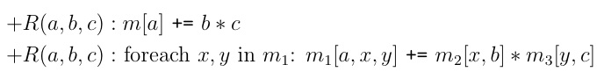
DBToaster: Next Directions
Bulk processing with Hadoop & HBase runtime:
M3: Product-Partition-Aggregate op
Working on:
Cost model for input, and intermediate result partitioning for M3 sequences
Whole program optimization of data placement & partitioning
+R
+S
+T
M
R
M
R
M
R
input
partition
map (product)
reduce
HBase

Slide 94
DBToaster: Next Directions
Query processing & computational foundations
Adaptivity spectrum: trade off incremental vs. from-scratch QP
Exploiting schema information (foreign-keys, constraints etc.)
Generalize incremental computation (recursion, collections etc.)
Compiling whole-DBMS, incorporating lightweight
Concurrency controller and scheduler
Optimizer and alerter
Storage layout

Slide 95
DBToaster: Conclusions
Extremely simple evaluation language: M3
Query “plans” in terms of data structures, not operators
Extremely easy to build runtimes: focus on architecture & context
Standalone stream engine, online MPP engine, bulk MPP engine
Query compilation: DBToaster
Novel recursive compilation technique
Revisits foundations for incremental processing
Natural mechanism to generate lightweight query engines

Slide 96
Research Summary
DBToaster: lightweight incremental query processing
Dissertation work: Pulse
Distributed data management:
Borealis: distributed stream processing engine
SAND: query processing over global-scale networks
SenseWeb: network-efficient indexing in sensor web portals
XPORT: extensible overlays for data collection and dissemination

Slide 97
Pulse: Declarative QP for Polynomial Models
Query processing over piecewise polynomials
Error handling, and the semantics of tuple/model discrepancies
select S.price from stocks R join stocks S on (R.t = S.t)
where R.id = A and S.id = B and R.price < S.price and R.price > c
Stock A
Tuple results
Stock B
Precision bounds
solve a + bx > c
c
solve

Slide 98
Mid-Term Research Agenda
Two central themes in future work:
Address limited expressiveness, features, and functionality
Pulse: numerical aspects of QP, declarative specification of models
Address scalability challenges:
DBToaster: simpler systems, rapid prototyping for DBMS-per-app
Numerical, analytical methods
Statistical , probabilistic methods
Query processing
Bridge research themes for large-scale numerical QP:
Data management tools have very limited numerical expressiveness
Apps: financial (algos), scientific (e.g. climate) simulation, services science, environment (e.g. carbon emissions) monitoring
Notes:
We’ll see Mom&Pop applications, i.e. many many more applications that make simple use of complex numerics than exists today, e.g. smart homes + heating automation + diffusion equation, we already see widespread use of motion models, what about very simple climate models, etc.

Slide 99
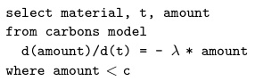

“NumDB?”: a Numerical Analysis DBMS
Challenges:
How do we formalize richer mathematical expressions and programming constructs and their properties w.r.t. relational calculus?
How do we combine symbolic and numerical processing of models, in addition to query processing?
How can we leverage the abundance of tools that provide parts of the big picture to build a top-to-bottom system?
QP
?
Generator
Storage

Slide 100



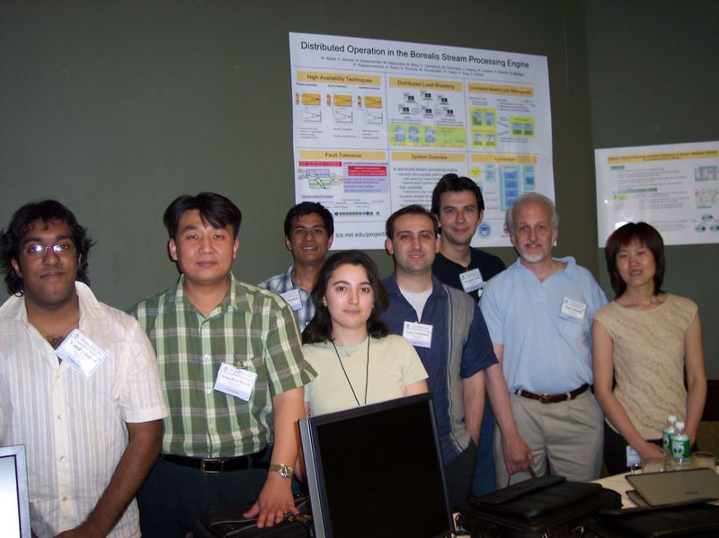
Thank you!
Acknowledgements:
DBToaster
Christoph Koch Oliver Kennedy
Pulse, Borealis, SAND, XPORT
Uğur Çetintemel The Borealis team

Slide 101
Additional Slides

Slide 102
Update-Intensive Applications
Clickstream analysis:
Active users of websites change dynamically, removal of click paths
Continuous queries over active users and selective history for business intelligence
Geospatial applications:
Entities contained within area of interest changes dynamically
Continuous queries over active entities for traffic control, etc.

Slide 103
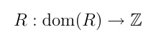
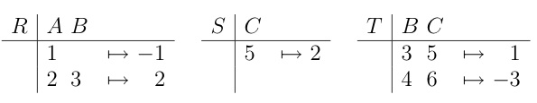
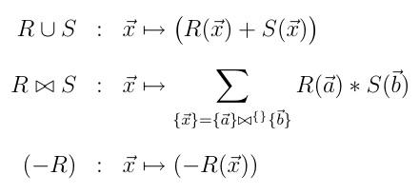
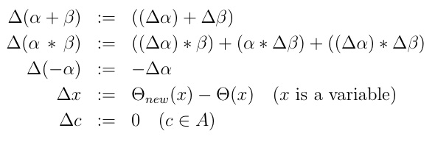
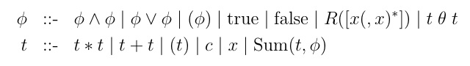
Formal Framework
Formal underpinnings:
Ring structure over relations
Ring defines + as union, x as natural join
Captures distributivity, associativity, and deltas
Aggregation calculus
Connects two rings, one of rational numbers, and another of the relational calculus
Multiset relations
Ring delta
Aggregation calculus

Slide 104
Normalized Aggregate Calculus
Polynomial calculus formulae
Recursively monomial formulae, used as inputs to factorization
Variable elimination via unification
Compute equivalence class of variables, and use for substitution
Aggregate extraction for recursive compilation
Replaces maximal non-constraints only Sum subterms with map lookups
Replaced term used as next input to compilation
Variable elimination for map argument simplification
Substitutes bound variables in map definitions (by lifting ifs)

Slide 105
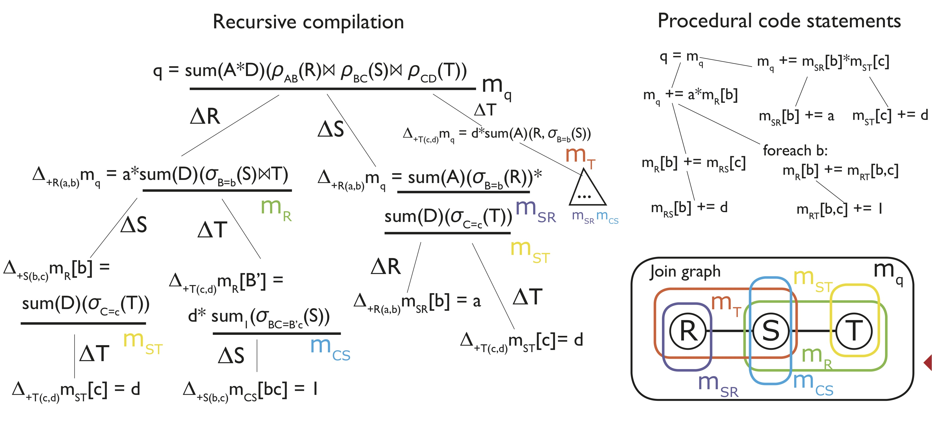
Delta Queries
Schemas: R(a,b), S(b,c), T(c,d)
Query: select sum(a*d) from R,S,T where R.b=S.b and S.c=T.c

Slide 106
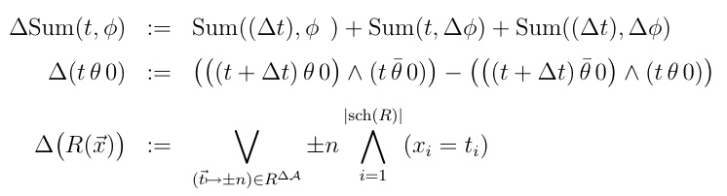
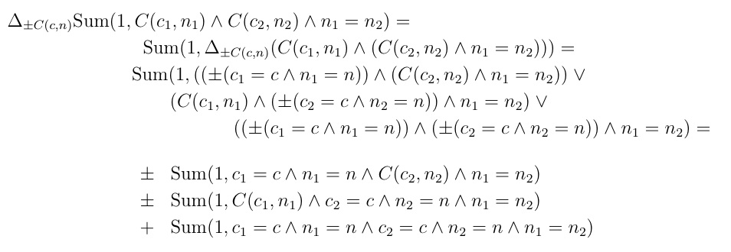
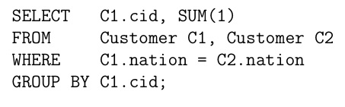
Delta Queries
Ring delta
Atomic term and formula delta

Slide 107
Query Factorization
select sum(L.revenue), P.partcat, D.year
from Date D, Part P
where D.datekey = L.datekey
and P.partkey = L.partkey
group by P.partcat, D.year

Slide 108
Query Factorization
foreach pc, y: q[pc, y] =
select sum(L.revenue)
from Date D, Part P
where D.datekey = L.datekey
and P.partkey = L.partkey
and P.partcat = pc
and D.year = y

Slide 109
Query Factorization
+L(xDK, xPK, xRev) foreach pc, y: q[pc,y] +=
select sum(L.revenue)
from Date D, Part P, {<xDK, xPK, xRev>} L
where D.datekey = L.datekey
and P.partkey = P.partkey
and P.partcat = pc
and D.year = y;

Slide 110
Query Factorization
+L(xDK, xPK, xRev) foreach pc, y: q[pc,y] +=
select sum(xRev)
from Date D, Part P
where D.datekey = xDK
and P.partkey = xPK
and P.partcat = pc
and D.year = y;
Factorization:
select sum(t*t’) from (Q x Q’) :=
(select sum(t) from Q) * (select sum(t’) from Q’)
when t is independent of Q’, and t’ of Q

Slide 111
Query Factorization
+L(xDK, xPK, xRev) foreach pc, y: q[pc,y] + =
xRev*
(select sum(1) from Date D
where D.datekey = xDK
and D.year = y)*
(select sum(1) from Part P
where P.partkey = xPK
and P.partcat = pc);
m1[datekey,year]
m2[partkey,partcat]

Slide 112
Compilation Highlights
Aggregation calculus
Query factorization
Delta queries
+L(xDK, xPK, xRev) foreach pc, y: q[pc,y] +=
select sum(xRev)
from Date D, Part P
where D.datekey = xDK
and P.partkey = xPK
and P.partcat = pc
and D.year = y;
select sum(L.revenue), P.partcat, D.year
from Date D, Part P, LineOrder L
where D.datekey = L.datekey
and P.partkey = L.partkey
group by P.partcat, D.year
select sum(t*t’) from (Q x Q’) :=
(select sum(t) from Q) *
(select sum(t’) from Q’)
when t is independent of Q’, and t’ of Q
+L(xDK, xPK, xRev) foreach pc, y: q[pc,y] + =
xRev*
(select sum(1) from Date D
where D.datekey = xDK
and D.year = y)*
(select sum(1) from Part P
where P.partkey = xPK
and P.partcat = pc);
m1[datekey,year]
m2[partkey,partcat]

Slide 113
Compilation Highlights
Aggregation calculus
Query factorization
Delta queries
select sum(t*t’) from (Q x Q’) :=
(select sum(t) from Q) *
(select sum(t’) from Q’)
when t is independent of Q’, and t’ of Q

Slide 114
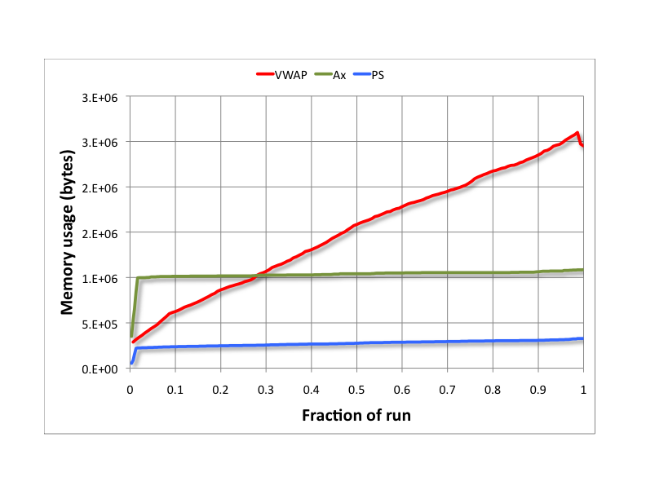
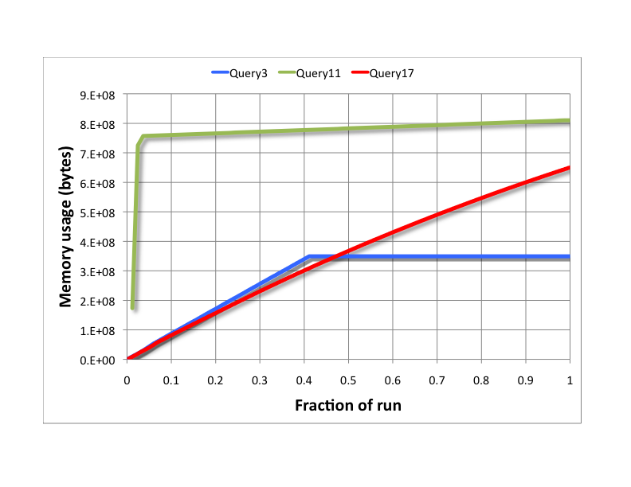
DBToaster: Memory Utilization
Order books are small (~1Mb), TPC-H queries are viable for large servers
VWAP and Q17 uses an old implementation of maintaining domains for initial values

Slide 115
Query Workload
Order book queries
TPC-H queries:
Query 3: shipping priority query
select l.orderkey, o.shippriority, sum(l.extendedprice)
from customer c, orders o, lineitem l
where c.custkey = o.custkey
and l.orderkey = o.orderkey
group by l.orderkey, o.shippriority;
VWAP: compute a vwap over the top 25% most voluminous orders
select sum(b.p*b.v)
from bids b
where 0.25*(select sum(b1.v) from bids b1) >
(select sum(b2.v) from bids b2 where b2.p > b.p);
Query 11: important stock identification query
select ps.partkey, sum(ps.supplycost * ps.availqty)
from partsupp ps, supplier s
where ps.suppkey = s.suppkey
group by ps.partkey having
sum(ps.supplycost * ps.availqty) >
(select sum(ps.supplycost * ps.availqty)
from partsupp ps, supplier s
where ps.suppkey = s.suppkey);
AX: find the ‘ax’ in an orderbook
select b.broker_id, sum(a.v-b.v)
from bids b, asks a
where b.broker_id = a.broker_id
and ( (a.p+-1*b.p > 1000) or (b.p+-1*a.p > 1000) )
group by b.broker_id
PS: compute the price spread between order books for significant orders
select sum(a.p-b.p)
from bids b, asks a
where ( b.v>0.0001*(select sum(b1.v) from bids b1) )
and ( a.v>0.0001*(select sum(a1.v) from asks a1) )
Query 17: small-quantity-order revenue query
select sum(l.extendedprice)
from lineitem l, parts p
where p.partkey = l.partkey
and l.quantity < 0.005*
(select sum(l2.quantity)
from lineitem l2 where l2.partkey = p.partkey);

Slide 116
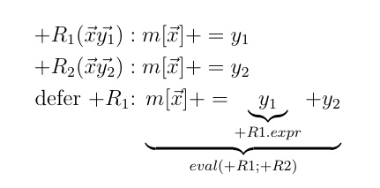
Cumulus: a push-based protocol
+R₂(xy₂)
+R₁(xy₁)
Cumulus relies on ordered updates at nodes
Observation: we can defer combining deltas
Tolerates out-of-orderness
Leads to fully push-based, replicated evaluation
Key takeaway: we break the atomicity of DBToaster’s triggers
Switch
put(dest, src, stmt, barrier)
Switch
Update
stream
Map
write
Update
stream
Write replica
Eval expr
Map
reads
update(params)
fetch(dest, src, xfers)
push(dest, src, entries)
update(seq, params)
push(dest, src, entries)

Slide 117
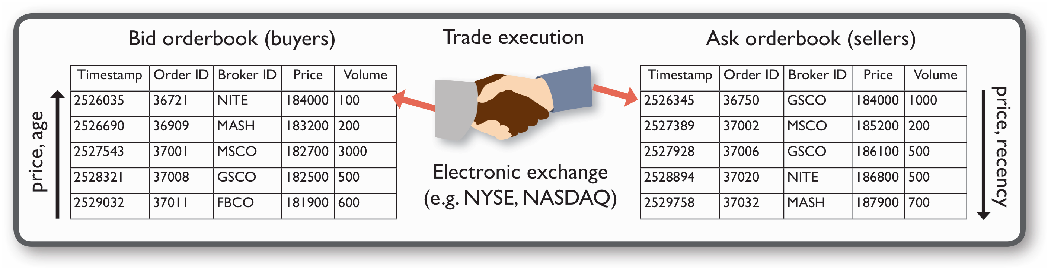
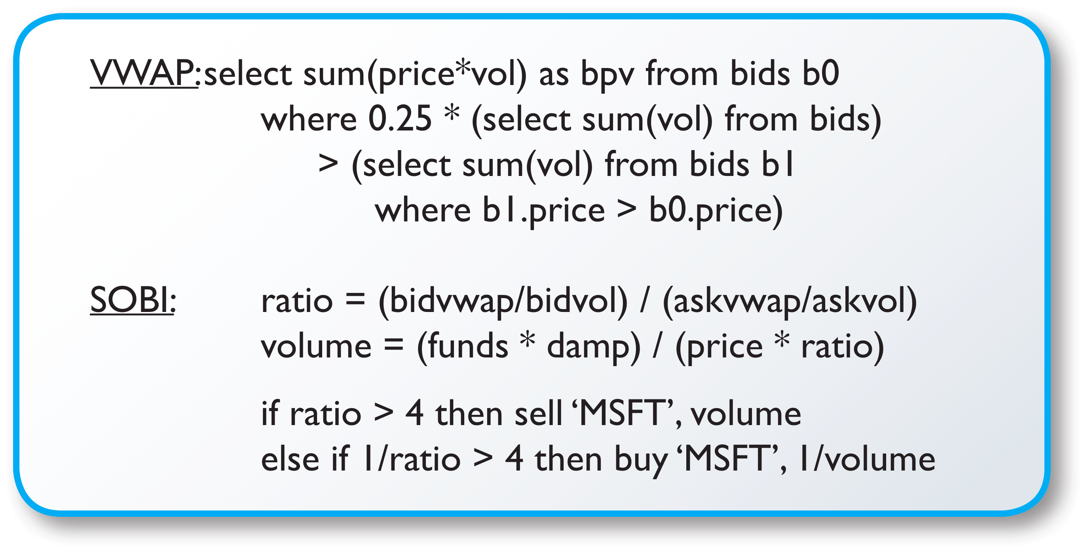
Application: Algorithmic Trading
Natural app for streaming: high-frequency algorithmic trading
Q1/2009: 73% of all equities trades in the US
~15% annual profit margin industry-wide
Bids (buyers) and asks (sellers) order book data
Order book trading
Arbitrary updates of order volumes
Wide variety of algos and actions:
Market makers, sniffers, icebergs
Static order book imbalance (SOBI)

Slide 118
Update Processing Example
TPCH-like schema for illustration
Part(PartKey, Name): P(PK, N)
Order(OrderKey, CustomerKey, Date, ExchangeRate)
O(OK, CK, D, XCH)
LineItem(OrderKey, PartKey, Price): LI(OK, PK, P)
Customer(CustomerKey, Name): C(CK, N)
select sum(LI.P * O.XCH)
from Order O, LineItem LI
where O.OK = LI.OK;

Slide 119
Compilation Example
q[] = select sum((A.p*A.v-B.p*B.v)*(A.t-B.t))
from Bids B, Asks A
where B.Bkid = A.Bkid;

Slide 120
Compilation Example
q[] = select sum((A.p*A.v-B.p*B.v)*(A.t-B.t))
from Bids B, Asks A
where B.bk_id = A.bk_id;
+B(xT,xOID,xBKID,xP,xV) q[] +=
select sum((A.p*A.v-xP*xV)*(A.t-xT))
from {<xT,xOID,xBKID,xP,xV>} B, Asks A
where xBKID = A.bk_id;
+A(yT,yOid,yBkid,yP,yV) q[] += ...

Slide 121
Compilation Example
q[] = select sum((A.p*A.v-B.p*B.v)*(A.t-B.t))
from Bids B, Asks A
where B.bk_id = A.bk_id;
+B(xT,xOID,xBKID,xP,xV) q[] +=
select sum(A.p*A.v*A.t)
- xT*sum(A.p*A.v)
- xP*xV*sum(A.t)
+ xP*xV*xT
from Asks A
where xBKID = A.bk_id;
+A(yT,yOid,yBkid,yP,yV) q[] += ...

Slide 122
Compilation Example
q1[xBKID]
q2[xBKID]
q3[xBKID]
q[] = select sum((A.p*A.v-B.p*B.v)*(A.t-B.t))
from Bids B, Asks A
where B.bk_id = A.bk_id;
+B(xT,xOID,xBKID,xP,xV) q[] += xP*xV*xT +
(select sum(A.p*A.v*A.t) from Asks A
where xBKID = A.bk_id)
- xT*(select sum(A.p*A.v) from Asks A
where xBKID = A.bk_id)
- xP*xV*(select sum(A.t) from Asks A
where xBKID = A.bk_id)
`
+A(yT,yOid,yBkid,yP,yV) q[] += ...

Slide 123
Full M3 Evaluation Example

Slide 124
M3: Evaluation Example
Δq1
q1[US]+=1
q1[UK]+=1
q1[UK]+=1
q1[US]+=1
q1[UK]-=1
q1[US]+=1
Trigger
Map: q1
Map: q2
Map: q
Trace: q
t |  | ΔC
nation
cid | nation
cid
Δq
Δq2
q2[1,US] += 1
q2[2,UK] += 1
q2[3,UK] += 1
q2[4,US]+=1
q2[3,UK]-=1
q2[3,US]+=1

Slide 125
M3: Evaluation Example
Δq1
q1[US]+=1
q1[UK]+=1
q1[UK]+=1
q1[US]+=1
q1[UK]-=1
q1[US]+=1
Trigger
Map: q1
Map: q2
Map: q
Trace: q
t |  | ΔC
1 | + | 1,US
nation
cid | nation
cid
1 | 1
Δq
q[1] += 1
Δq2
q2[1,US] += 1
q2[2,UK] += 1
q2[3,UK] += 1
q2[4,US]+=1
q2[3,UK]-=1
q2[3,US]+=1

Slide 126
M3: Evaluation Example
Δq1
q1[US]+=1
q1[UK]+=1
q1[UK]+=1
q1[US]+=1
q1[UK]-=1
q1[US]+=1
Trigger
Map: q1
Map: q2
Map: q
Trace: q
t |  | ΔC
1 | + | 1,US
nation
US | 1
cid | nation
1 | US | 1
cid
1 | 1
Δq
q[1] += 1
Δq2
q2[1,US] += 1
q2[2,UK] += 1
q2[3,UK] += 1
q2[4,US]+=1
q2[3,UK]-=1
q2[3,US]+=1

Slide 127
M3: Evaluation Example
Δq1
q1[US]+=1
q1[UK]+=1
q1[UK]+=1
q1[US]+=1
q1[UK]-=1
q1[US]+=1
Trigger
Map: q1
Map: q2
Map: q
Trace: q
t |  | ΔC
1 | + | 1,US
2 | + | 2,UK
nation
US | 1
cid | nation
1 | US | 1
cid
1 | 1
2 | 1
Δq
q[1] += 1
q[2] += 1
Δq2
q2[1,US] += 1
q2[2,UK] += 1
q2[3,UK] += 1
q2[4,US]+=1
q2[3,UK]-=1
q2[3,US]+=1

Slide 128
M3: Evaluation Example
Δq1
q1[US]+=1
q1[UK]+=1
q1[UK]+=1
q1[US]+=1
q1[UK]-=1
q1[US]+=1
Trigger
Map: q1
Map: q2
Map: q
Trace: q
t |  | ΔC
1 | + | 1,US
2 | + | 2,UK
nation
US | 1
UK | 1
cid | nation
1 | US | 1
2 | UK | 1
cid
1 | 1
2 | 1
Δq
q[1] += 1
q[2] += 1
Δq2
q2[1,US] += 1
q2[2,UK] += 1
q2[3,UK] += 1
q2[4,US]+=1
q2[3,UK]-=1
q2[3,US]+=1

Slide 129
M3: Evaluation Example
Δq1
q1[US]+=1
q1[UK]+=1
q1[UK]+=1
q1[US]+=1
q1[UK]-=1
q1[US]+=1
Trigger
Map: q1
Map: q2
Map: q
Trace: q
t |  | ΔC
1 | + | 1,US
2 | + | 2,UK
3 | + | 3.UK
nation
US | 1
UK | 1
cid | nation
1 | US | 1
2 | UK | 1
cid
1 | 1
2 | 2
3 | 2
Δq
q[1] += 1
q[2] += 1
q[3] += q1[UK] + 1 q[2] += q2[2,UK]
Δq2
q2[1,US] += 1
q2[2,UK] += 1
q2[3,UK] += 1
q2[4,US]+=1
q2[3,UK]-=1
q2[3,US]+=1

Slide 130
M3: Evaluation Example
Δq1
q1[US]+=1
q1[UK]+=1
q1[UK]+=1
q1[US]+=1
q1[UK]-=1
q1[US]+=1
Trigger
Map: q1
Map: q2
Map: q
Trace: q
t |  | ΔC
1 | + | 1,US
2 | + | 2,UK
3 | + | 3.UK
nation
US | 1
UK | 2
cid | nation
1 | US | 1
2 | UK | 1
3 | UK | 1
cid
1 | 1
2 | 2
3 | 2
Δq
q[1] += 1
q[2] += 1
q[3] += q1[UK] + 1 q[2] += q2[2,UK]
Δq2
q2[1,US] += 1
q2[2,UK] += 1
q2[3,UK] += 1
q2[4,US]+=1
q2[3,UK]-=1
q2[3,US]+=1

Slide 131
M3: Evaluation Example
Δq1
q1[US]+=1
q1[UK]+=1
q1[UK]+=1
q1[US]+=1
q1[UK]-=1
q1[US]+=1
Trigger
Map: q1
Map: q2
Map: q
Trace: q
t |  | ΔC
1 | + | 1,US
2 | + | 2,UK
3 | + | 3.UK
4 | + | 4,US
nation
US | 1
UK | 2
cid | nation
1 | US | 1
2 | UK | 1
3 | UK | 1
cid
1 | 2
2 | 2
3 | 2
4 | 2
Δq
q[1] += 1
q[2] += 1
q[3] += q1[UK] + 1 q[2] += q2[2,UK]
q[4] += q1[US] + 1 q[1] += q2[1,US]
Δq2
q2[1,US] += 1
q2[2,UK] += 1
q2[3,UK] += 1
q2[4,US]+=1
q2[3,UK]-=1
q2[3,US]+=1

Slide 132
M3: Evaluation Example
Δq1
q1[US]+=1
q1[UK]+=1
q1[UK]+=1
q1[US]+=1
q1[UK]-=1
q1[US]+=1
Trigger
Map: q1
Map: q2
Map: q
Trace: q
t |  | ΔC
1 | + | 1,US
2 | + | 2,UK
3 | + | 3.UK
4 | + | 4,US
nation
US | 2
UK | 2
cid | nation
1 | US | 1
2 | UK | 1
3 | UK | 1
4 | US | 1
cid
1 | 2
2 | 2
3 | 2
4 | 2
Δq
q[1] += 1
q[2] += 1
q[3] += q1[UK] + 1 q[2] += q2[2,UK]
q[4] += q1[US] + 1 q[1] += q2[1,US]
Δq2
q2[1,US] += 1
q2[2,UK] += 1
q2[3,UK] += 1
q2[4,US]+=1
q2[3,UK]-=1
q2[3,US]+=1

Slide 133
M3: Evaluation Example
Δq1
q1[US]+=1
q1[UK]+=1
q1[UK]+=1
q1[US]+=1
q1[UK]-=1
q1[US]+=1
Trace: q
Trigger
Map: q1
Map: q2
Map: q
Δq
q[1] += 1
q[2] += 1
q[3] += q1[UK] + 1 q[2] += q2[2,UK]
q[4] += q1[US] + 1 q[1] += q2[1,US]
q[3] -= q1[UK] - 1 q[2] -= q2[2,UK]
t |  | ΔC
1 | + | 1,US
2 | + | 2,UK
3 | + | 3.UK
4 | + | 4,US
5 | - | 3,UK
nation
US | 2
UK | 2
cid | nation
1 | US | 1
2 | UK | 1
3 | UK | 1
4 | US | 1
cid
1 | 2
2 | 1
3 | 0
4 | 2
Δq2
q2[1,US] += 1
q2[2,UK] += 1
q2[3,UK] += 1
q2[4,US]+=1
q2[3,UK]-=1
q2[3,US]+=1

Slide 134
M3: Evaluation Example
Δq1
q1[US]+=1
q1[UK]+=1
q1[UK]+=1
q1[US]+=1
q1[UK]-=1
q1[US]+=1
Trace: q
Trigger
Map: q1
Map: q2
Map: q
Δq
q[1] += 1
q[2] += 1
q[3] += q1[UK] + 1 q[2] += q2[2,UK]
q[4] += q1[US] + 1 q[1] += q2[1,US]
q[3] -= q1[UK] - 1 q[2] -= q2[2,UK]
t |  | ΔC
1 | + | 1,US
2 | + | 2,UK
3 | + | 3.UK
4 | + | 4,US
5 | - | 3,UK
nation
US | 2
UK | 1
cid | nation
1 | US | 1
2 | UK | 1
3 | UK | 0
4 | US | 1
cid
1 | 2
2 | 1
3 | 0
4 | 2
Δq2
q2[1,US] += 1
q2[2,UK] += 1
q2[3,UK] += 1
q2[4,US]+=1
q2[3,UK]-=1
q2[3,US]+=1

Slide 135
M3: Evaluation Example
Δq1
q1[US]+=1
q1[UK]+=1
q1[UK]+=1
q1[US]+=1
q1[UK]-=1
q1[US]+=1
Trace: q
Δq
q[1] += 1
q[2] += 1
q[3] += q1[UK] + 1 q[2] += q2[2,UK]
q[4] += q1[US] + 1 q[1] += q2[1,US]
q[3] -= q1[UK] - 1 q[2] -= q2[2,UK]
q[3] += q1[US] + 1 q[1] += q2[1,US] q[4] += q2[4,US]
Trigger
Map: q1
Map: q2
Map: q
t |  | ΔC
1 | + | 1,US
2 | + | 2,UK
3 | + | 3.UK
4 | + | 4,US
5 | - | 3,UK
6 | + | 3,US
nation
US | 2
UK | 1
cid | nation
1 | US | 1
2 | UK | 1
3 | UK | 0
4 | US | 1
cid
1 | 3
2 | 1
3 | 3
4 | 3
Δq2
q2[1,US] += 1
q2[2,UK] += 1
q2[3,UK] += 1
q2[4,US]+=1
q2[3,UK]-=1
q2[3,US]+=1

Slide 136
M3: Evaluation Example
Δq1
q1[US]+=1
q1[UK]+=1
q1[UK]+=1
q1[US]+=1
q1[UK]-=1
q1[US]+=1
Trace: q
Δq
q[1] += 1
q[2] += 1
q[3] += q1[UK] + 1 q[2] += q2[2,UK]
q[4] += q1[US] + 1 q[1] += q2[1,US]
q[3] -= q1[UK] - 1 q[2] -= q2[2,UK]
q[3] += q1[US] + 1 q[1] += q2[1,US] q[4] += q2[4,US]
Trigger
Map: q1
Map: q2
Map: q
t |  | ΔC
1 | + | 1,US
2 | + | 2,UK
3 | + | 3.UK
4 | + | 4,US
5 | - | 3,UK
6 | + | 3,US
nation
US | 3
UK | 1
cid | nation
1 | US | 1
2 | UK | 1
3 | UK | 0
4 | US | 1
3 | US | 1
cid
1 | 3
2 | 1
3 | 3
4 | 3
Δq2
q2[1,US] += 1
q2[2,UK] += 1
q2[3,UK] += 1
q2[4,US]+=1
q2[3,UK]-=1
q2[3,US]+=1

Slide 137
Stream Processing Slides

Slide 138
The State of the Art in Update Processing
Stream processing is unsuitable for update-intensive apps
Streams do not decouple data scoping and data manipulation
Snapshots
Data stream
t | oid | bid | p | v
1 | 1 | 2 | 90 | 25
2 | 2 | 1 | 50 | 40
t | oid | bid | p | v
1 | 1 | 2 | 90 | 25
2 | 2 | 1 | 50 | 40
3 | 3 | 2 | 40 | 80
4 | 2 | 1 | 60 | 100

Slide 139
The State of the Art in Update Processing
Stream processing is unsuitable for update-intensive apps
Streams do not decouple data scoping and data manipulation
Continuous query
t | oid | bid | p | v
5 | 4 | 2 | 100 | 50
9 | 2 | 1 | 80 | 80
6 | 6 | 1 | 80 | 50
Scope
Data stream

Slide 140
The State of the Art in Update Processing
Stream processing is unsuitable for update-intensive apps
Streams do not decouple data scoping and data manipulation
Continuous query
t | oid | bid | p | v
5 | 4 | 2 | 100 | 50
9 | 2 | 1 | 80 | 80
6 | 6 | 1 | 80 | 50
Scope
Data stream

Slide 141
The State of the Art in Update Processing
Stream processing is unsuitable for update-intensive apps
Streams do not decouple data scoping and data manipulation
Snapshots
Data stream
Snapshot updates
t | oid | bid | p | v
5 | 4 | 2 | 100 | 50
9 | 2 | 1 | 80 | 80
6 | 6 | 1 | 80 | 50

Slide 142
The State of the Art in Update Processing
Stream processing is unsuitable for update-intensive apps
Streams do not decouple data scoping and data manipulation
Continuous query
t | oid | bid | p | v
5 | 4 | 2 | 100 | 50
9 | 2 | 1 | 80 | 80
6 | 6 | 1 | 80 | 50
Query scope
Data stream
Snapshot updates
t | oid | bid | p | v
5 | 4 | 2 | 100 | 50
9 | 2 | 1 | 80 | 80
6 | 6 | 1 | 80 | 50

Slide 143
The State of the Art in Update Processing
Stream processing is unsuitable for update-intensive apps
Streams do not decouple data scoping and data manipulation
Continuous query
t | oid | bid | p | v
5 | 4 | 2 | 100 | 50
9 | 2 | 1 | 80 | 80
6 | 6 | 1 | 80 | 50
Query scope
Data stream
Snapshot updates
t | oid | bid | p | v
5 | 4 | 2 | 100 | 50
9 | 2 | 1 | 80 | 80
6 | 6 | 1 | 80 | 50

Slide 144
Bulk Processing Slides

Slide 145
DBToaster: Next Directions
Bulk vs. incremental query processing
q[] = select sum(LI.P * O.XCH)
from Order O, LineItem LI
where O.OK = LI.OK;
+O(xOK, xCK, xD, xXCH) q[] += xXCH * qO[xOK];
+LI(yOK, yPK, yP) qO[yOK] += yP;
+LI(yOK, yPK, yP) q[] += yP * qLI[yOK];
+O(xOK, xCK, xD, xXCH) qLI[xOK] += xXCH;
q[]
+O
+LI
qO[yOK]
qLI[xOK]
+LI
+O
yP
xXCH

Slide 146
DBToaster: Next Directions
Bulk vs. incremental query processing
No need to compute all paths, just one
Picking the right one seems like join ordering
Different cost model because of aggregate distributivity
select sum(a*d) from R,S,T where R.b=S.b and S.c=T.c

Slide 147
DBToaster: Next Directions
Bulk vs. incremental query processing
No need to compute all paths, just one
select sum(a*d) from R,S,T where R.b=S.b and S.c=T.c

Slide 148
DBToaster: Next Directions
Bulk vs. incremental query processing
No need to compute all paths, just one
Picking the right one seems like join ordering
Different cost model because of aggregate distributivity
select sum(a*d) from R,S,T where R.b=S.b and S.c=T.c
+R; +S; +T

Slide 149
Bulk Tuple Processing
q[] = select sum(R.a * T.d)
from R, S, T
where R.b = S.b and S.c = T.c;
+R(xA, xB) q[] += xA * qST[xB];
+S(xB, xC) qST[xB] += qT[xC];
+T(xC, xD) qT[xC] += xD;

Slide 150
Bulk Tuple Processing on Hadoop
q[] = select sum(R.a * T.d)
from R, S, T
where R.b = S.b and S.c = T.c;
+R(xA, xB): q[] += xA * qST[xB];
+S(xB, xC): qST[xB] += qT[xC];
+T(xC, xD): qT[xC] += xD;
qT
R
Red
Map
T
input
sort
map
HBase
(… or HDFS)
reduce

Slide 151
Bulk Tuple Processing on Hadoop
q[] = select sum(R.a * T.d)
from R, S, T
where R.b = S.b and S.c = T.c;
+R(xA, xB): q[] += xA * qST[xB];
+S(xB, xC): qST[xB] += qT[xC];
+T(xC, xD): qT[xC] += xD;
Stage 3
q
R
Red
qST
Map
R
Stage 2
HBase
qST
R
Red
qT
Map
S
Stage 1
qT
R
Red
Map
T
input
sort
map
reduce

Slide 152
Bulk Tuple Processing: Map Slices
q[] = select sum(R.a * T.d)
from R, S, T
where R.b = S.b and S.c = T.c;
+R(xA, xB): q[] += xA * qST[xB];
+T(xC, xD): foreach b: qST[b] += xD * qS[b,xC];
+S(xB, xC): qT[xC] += xD;

Slide 153
Bulk Tuple Processing: Map Slices
q[] = select sum(R.a * T.d)
from R, S, T
where R.b = S.b and S.c = T.c;
+R(xA, xB): q[] += xA * qST[xB];
+T(xC, xD): foreach b: qST[b] += xD * qS[b,xC];
+S(xB, xC): qT[xC] += xD;

Slide 154
Bulk Tuple Processing: Map Slices
q[] = select sum(R.a * T.d)
from R, S, T
where R.b = S.b and S.c = T.c;
+R(xA, xB): q[] += xA * qST[xB];
+T(xC, xD): for b in qS[*,xC]: qST[b] += xD * qS[b,xC];
+S(xB, xC): qT[xC] += xD;
slice

Slide 155
Bulk Tuple Processing: Multiple Maps
+R(a,b,c): for x,y: m1[a,x,y] += m2[b,x] * m3[c,y];

Slide 156
Bulk Tuple Processing: Multiple Maps
+R(a,b,c): for x,y: m1[a,x,y] += m2[b,x] * m3[c,y];

Slide 157
Bulk Tuple Processing: Multiple Maps
+R(a,b,c): for x,y: m1[a,x,y] += m2[b,x] * m3[c,y];
+R(a,b,c): m1[a,*₁,*₂] += m2[b,*₁] * m3[c,*₂];
slice
slice
cross product

Slide 158
Bulk Tuple Processing: Summary
Bulk processing with Hadoop & HBase runtime:
M3: Product-Partition-Aggregate op
… or a key-value/aggregate “language”
Working on:
Cost model for input, and intermediate result partitioning for M3 sequences
Whole program optimization of data placement & partitioning
+R
+S
+T
input
partition (sort)
product (map)
M
R
M
R
M
R
aggregate (reduce)
HBase

Slide 159
M3 Slides

Slide 160
M3 : the Director’s Cut
+R(ABC):
foreach XY in m[XV][YZ]:
m[XB][YC] += ((m1[x_{i}b_{i}][y_{i}c_{i}] * a₁) + (a₃*a₄) + (m2[x_{j}b_{j}][y_{j}c_{j}]*a₂)
Variable classes and definitions:
Trigger (bound): variables defined in the input tuple, e.g. ABC.
Input: map access vars defined from “above”, e.g. XB in m[XB][YC]
“above”: vars remaining from a previous compilation level
Output: map access vars defined from “within”, e.g. YC in m[XB][YC]
“within”: vars used for query results , e.g. for group-bys
Loop: LHS vars not defined in trigger, e.g. X,Y in m[XB][YC] above
Bigsum: RHS vars not defined on LHS, occurs because of nested aggregates
input
output
LHS
RHS

Slide 161
Initial Value Computation
+R(ABC):
foreach XY in m[XV][YZ]:
m[XB][YC] += ((m1[x_{i}b_{i}][y_{i}c_{i}] * a₁) + (a₃*a₄) + (m2[x_{j}b_{j}][y_{j}c_{j}]*a₂)
On map lookups, for unseen input vars
e.g. accessing m1 with unseen values of b_{i}
On statement execution, for unseen output vars
e.g. new values of C when updating map m
Initial value mechanisms:
Recursive maintenance, and incremental processing
Naïve map-based relational-style bulk processing

Slide 162
M3 Evaluation
+R(ABC):
foreach XY in m[XV][YZ]:
m[XB][YC] = m[XB][YC] + ((m1[x_{i}b_{i}][y_{i}c_{i}] * a₁) + (a₃*a₄) + (m2[x_{j}b_{j}][y_{j}c_{j}]*a₂)
slice
singleton
slice
MapAccess(pat1,pat2): inv access
init, index pat1, update
slice pat2, copy, strip
Var
MapAccess
Var
⨝_{hash}
select * from LHS⨝RHS
where LHS.bv_{i} = RHS.bv_{i}
compile_op
compile_op
compile_op(v₁,v₂): eval LHS, fold,
extend Θ v1, eval RHS, map op, concat_keys v2, union
compile_op(v1,v2):
eval LHS, extend Θ v1, eval RHS, …
unindexed
maps
mapi -> reindex
compile_pcalc: compile_op/MapAccess/…
compile_pcalc2(pat,v): eval, add_secondary_index(pat), project_keys(v)
indexed aggregate
fold_index -> aggregate_slice
compile_pstmt(v): eval, merge
extend Θ, init
update current
sl1,sl2= partition_diff(delta, current)
foreach sl1: extend th, init
foreach sl2: update current
compile_pstmt_loop(pat, v): slice(pat)/lookup, extend Θ, inv access, outv access, eval, update

